Slide 2
WELCOME & INTRODUCTION
Today we are excited to gather together to talk about:
Who we are as UNANIMA International
What we’re doing and how we do it at the United Nations
What we are doing, how we are doing at the Grassroots
Making further connections between UNANIMA International at the United Nations and the Grassroots

Slide 3
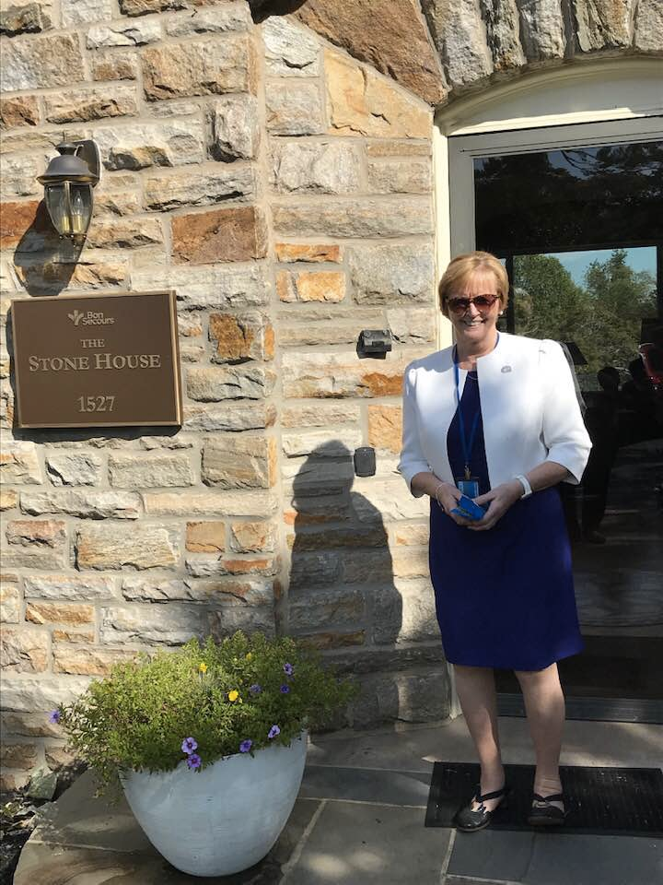
JEAN QUINN, DW OUR EXECUTIVE DIRECTOR
Sophia Housing
GBI Leadership
UNANIMA International Board Member
UNANIMA International Executive Director
Notes:
At the Chapter of 2012 we decided to join UNANIMA International and I was our first Board Member in 2015
2017 I was appointed Executive Director of UNANIMA International.
Sophia Housing
GBI Leadership
UNANIMA International Board Member
UNANIMA International Executive Director

Slide 4
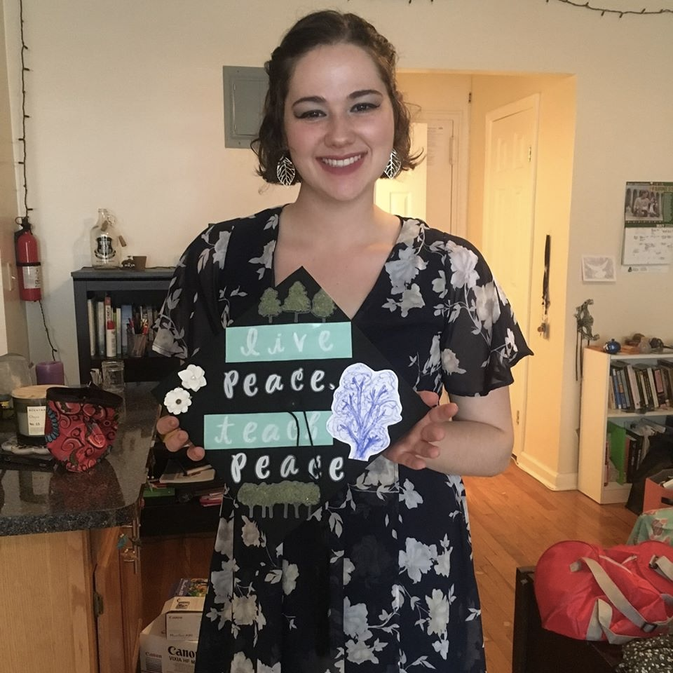
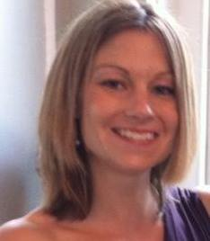
OUR NEW YORK CITY TEAM
Molly Gerke Executive Assistant
Jean Quinn, DW Executive Director
Eliza Gelfand Administrative Assistant
Kirin Taylor Research Fellow

Slide 5
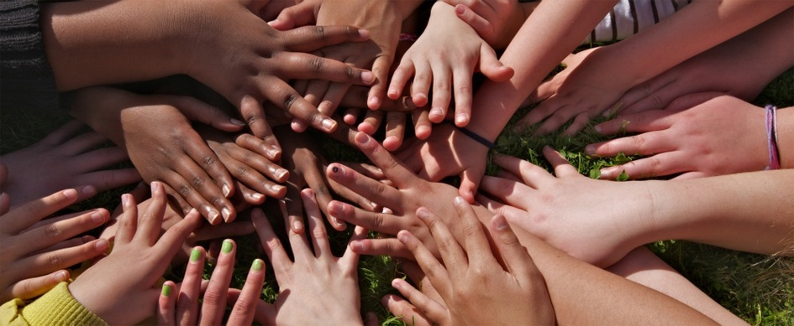
UNANIMA INTERNATIONAL
A coalition of 22 congregations of women religious and friends as well as their missions partners
Member base of over 23,000 globally
Founded in 2002

Slide 6
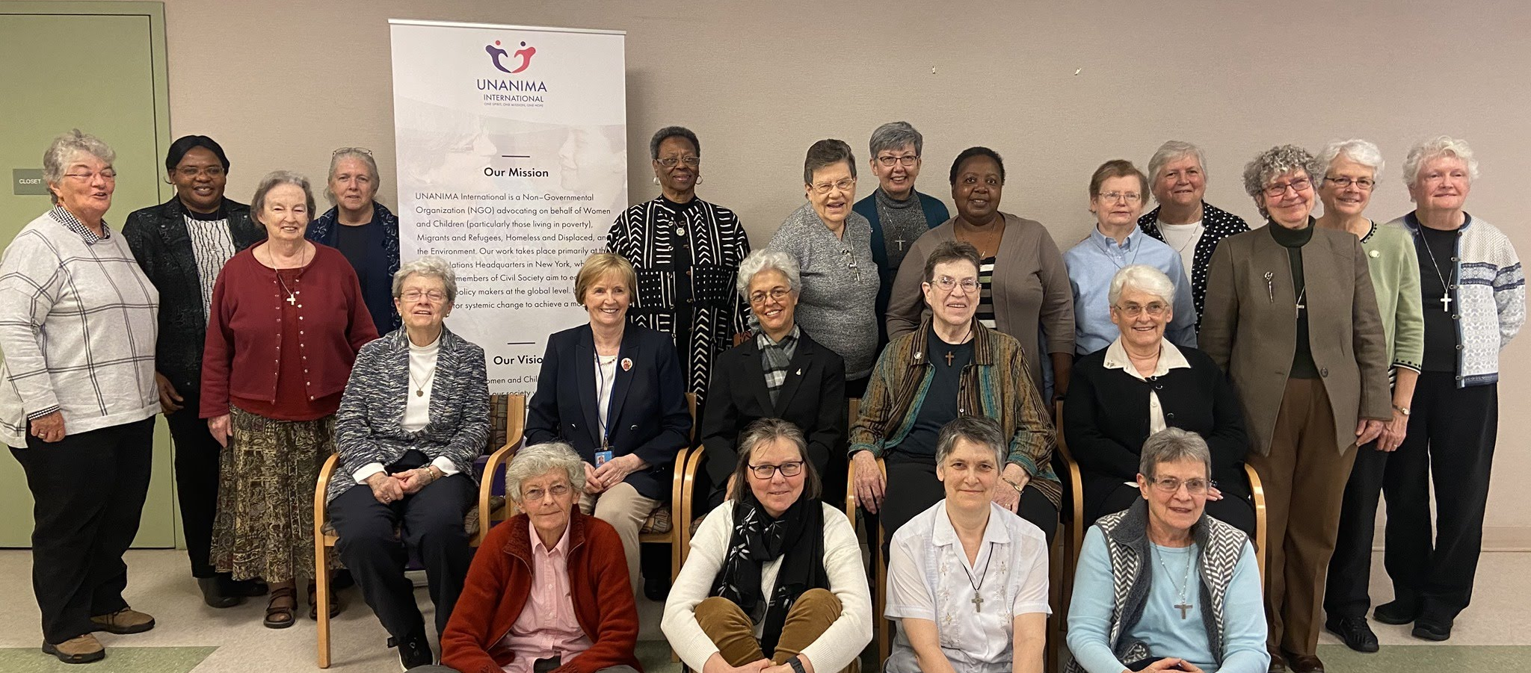
WHO ARE WE?
We are a coalition of religious women who bring their voices, concerns and experience as educators, health care providers, social workers, development and community builders to the United Nations.
UNANIMA International Board, February 2020
Notes:
From its humble beginnings of 7 charter members, Francisca Mota, CCV; Jean O’Meara, SHCJ, Pres.; Janice Farnham, RJM, VP; Jacinta Powers, OSU; Roselle Santivasi, MSC Sec/Treas; Lise Gagnon, SNJM; Catherine Ferguson,SNJM, Coordinator; Pat Hayes, CSA UI has grown and evolved over the last 17 years. Here you can see a picture from our most recent Board Meeting (March 2019).
Top: Back Row -Stacy Hanrahan, Barbara Jean Head, Nonata Bezerra, Cathy Sheehan, Ellen Sinclair, Anne McCabe, Fran Gorsuch, Janice Belanger, Margaret Fyfe, Margaret Scott, Maureen Foltz, Pereka Nyirenda, Josee Therrien, Ces Martin, Eileen Davey
Front Row- Barbara Spears, Jean Quinn, Lucille Goulet, Mary Akinwale and Janet Petersworth

Slide 7
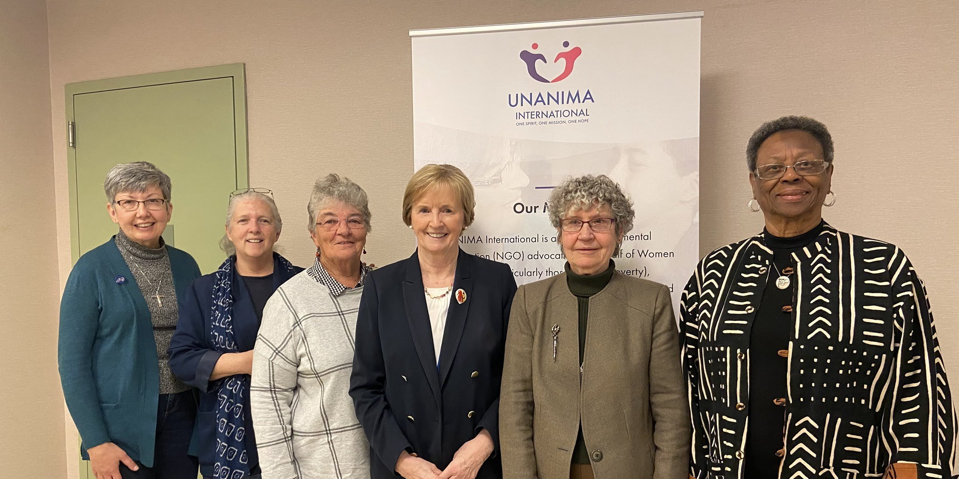
EXECUTIVE COMMITTEE

Slide 8
Religious of Jesus and Mary
Religious Sisters of Charity (Ireland and Australia
Sisters of the Assumption of the Blessed Virgin
Sisters of the Divine Savior (Salvatorian Sisters)
Sisters of the Holy Names of Jesus and Mary
Sisters of Notre Dame
Sisters of Providence
Sisters of St. Anne
Society of the Holy Child Jesus
Ursuline Charism Group
Ursuline Sisters of Mt. St. Joseph
+UNANIMA International’s Friends
Carmelite Sisters of Charity, Vedruna
Congregation de Notre Dame
Congregation of Bon Secours of Paris
Congregation of Mary (Marist Sisters)
Congregation of Saint Brigid (Brigidines)
Congregation of Sisters of St. Agnes
Daughters of Wisdom
Handmaids of the Sacred Heart of Jesus
Holy Union Sisters
Missionary Sisters of the Sacred Heart
Notre Dame de Sion
Notes:
We are now 22 congregations as seen on the screen. Friends Sisters of the Most Precious Blood of O’Fallon Missouri

Slide 9
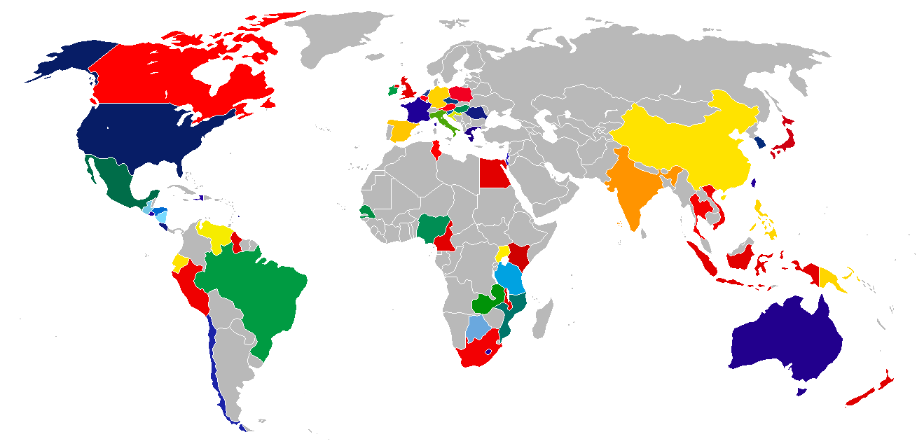
A GLOBAL PICTURE
WHERE ARE YOU?
Notes:
UNANIMA International has members in 85 countries, globally. We have members in each of the UN regions and on every continent, excluding Antarctica.

Slide 10
“UNA - WHAT?”
United Nations
+
ANIMA
--the feminine soul, vital force, life principle-- UNANIMOUS?
Notes:
The name begins with “UN” to represent the United Nations, and the “ANIMA” is from the Latin word for feminine “spirit” or “life principle.” It not only indicates that the organization is bringing the feminine spirit to the UN, but (as it brings to mind the word, “unanimous”) that it represents a group acting with one heart and mind.

Slide 11
OUR VISION & MISSION
A future where Women and Children who live in extreme poverty in our society will be empowered to achieve a better quality of life.
UNANIMA International is a Non –Governmental Organization (NGO) advocating on behalf of Women and Children (particularly those living, in poverty), the Homeless and Displaced, those Trafficked, Migrants and Refugees, and the Environment. Our work takes place primarily at the United Nations Headquarters in New York, where we and other members of Civil Society aim to educate and influence policy makers at the global level. In solidarity, we work for systemic change to achieve a more just world.
Notes:
Mission and vision both on slide

Slide 12
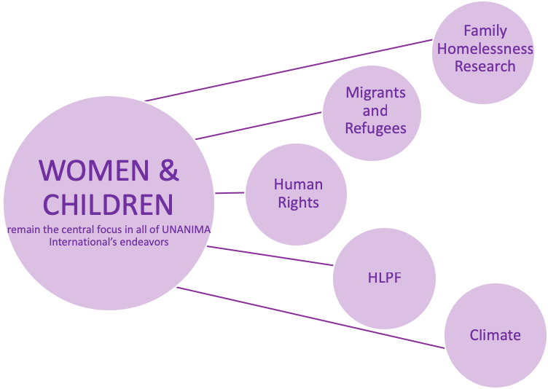
UNANIMA INTERNATIONAL
FOCUS
&
Commissions
Notes:
As it states in our mission and vision, Women and Children remain central to everything we do at UNANIMA International. Currently our work at the UN has 5 focuses; UNANIMA International’s Major Research Project into Family Homelessness and Trauma, Migrants and Refugees, Human Rights, the High Level Political Forum and commissions and Climate. Just like the individual goals each of these focuses are connected to all 17 SDGs and each other. Add commissions

Slide 13
QUESTIONS?

Slide 14
THE UNITED NATIONS
Notes:
The United Nations was born of perceived necessity, as a means of better arbitrating international conflict and negotiating peace than was provided for by the old League of Nations. The growing Second World War became the real impetus for the United States, Britain, and the Soviet Union to begin formulating the original U.N. Declaration, signed by 26 nations in January 1942, as a formal act of opposition to Germany, Italy, and Japan, the Axis Powers. The principles of the U.N. Charter were first formulated at the San Francisco Conference, which convened on April 25, 1945. It was presided over by President Franklin Roosevelt, British Prime Minister Winston Churchill, and Soviet Premier Joseph Stalin, and attended by representatives of 50 nations, including 9 continental European states, 21 North, Central, and South American republics, 7 Middle Eastern states, 5 British Commonwealth nations, 2 Soviet republics (in addition to the USSR itself), 2 East Asian nations, and 3 African states. The conference laid out a structure for a new international organization that was to “save succeeding generations from the scourge of war,…to reaffirm faith in fundamental human rights,…to establish conditions under which justice and respect for the obligations arising from treaties and other sources of international law can be maintained, and to promote social progress and better standards of life in larger freedom.”
The name "United Nations", coined by United States President Franklin D. Roosevelt was first used in the Declaration by United Nations of 1 January 1942, during the Second World War, when representatives of 26 nations pledged their Governments to continue fighting together against the Axis Powers.
In 1945, representatives of 50 countries met in San Francisco at the United Nations Conference on International Organization to draw up the United Nations Charter. Those delegates deliberated on the basis of proposals worked out by the representatives of China, the Soviet Union, the United Kingdom and the United States at Dumbarton Oaks, United States in August-October 1944.
The Charter was signed on 26 June 1945 by the representatives of the 50 countries. Poland, which was not represented at the Conference, signed it later and became one of the original 51 Member States.

Slide 15
THE HISTORY OF THE UNITED NATIONS
The United Nations is an international organization founded in 1945 after the Second World War by 51 countries committed to maintaining international peace and security, developing friendly relations among nations and promoting social progress, better living standards and human rights.
Due to its unique international character, and the powers vested in its founding Charter, the Organization can take action on a wide range of issues, and provide a forum for its 193 Member States to express their views, through the General Assembly, the Security Council, the Economic and Social Council and other bodies and committees.
Notes:
The UN has 4 main purposes
To keep peace throughout the world;
To develop friendly relations among nations;
To help nations work together to improve the lives of poor people, to conquer hunger, disease and illiteracy, and to encourage respect for each other’s rights and freedoms;
To be a centre for harmonizing the actions of nations to achieve these goals

Slide 16
THE UN CHARTER:
WE, THE PEOPLES OF THE UNITED NATIONS, DETERMINED
to save succeeding generations from the scourge of war, which twice in our lifetime has brought untold sorrow to mankind, and
to reaffirm faith in fundamental human rights, in the dignity and worth of the human person, in the equal rights of men and women and of nations large and small, and
to establish conditions under which justice and respect for the obligations arising from treaties and other sources of international law can be maintained, and
to promote social progress and better standards of life in larger freedom,

Slide 17
THE UN CHARTER:
AND FOR THESE ENDS
to practice tolerance and live together in peace with one another as
good neighbours, and
to unite our strength to maintain international peace and security, and
to ensure, by the acceptance of principles and the institution of methods, that armed force shall not be used, save in the common interest, and
to employ international machinery for the promotion of the economic
and social advancement of all peoples…

Slide 18
THE POLITICAL IS SPIRITUAL
“It is important to realize that there is an element of
spirituality needed in what we do…
Stop the trend of dividing humanity to ‘us’ and ‘them.’ The most important word in the world is ‘TOGETHER.’”
-H.E. Jan Eliasson
former UN Deputy Secretary General

Slide 19
…AND THE SPIRITUAL IS POLITICAL
Lk 4/18-19: “The Spirit of the Lord …has anointed me to bring glad
tidings to the poor. [It] has sent me to proclaim liberty to captives
and recovery of sight to the blind, to let the oppressed go free,
and to proclaim a year acceptable to the Lord.”
Mt 25/ 40: “Whenever you did it to the least of my brothers/sisters, you did it to me.”
Pope Francis: “A prayer that does not lead you to practical action
for your brother—the poor, the sick, those in need of help, a
brother in difficulty—is a sterile and incomplete prayer.” (Angelus,
7/21/13)

Slide 20
…AND ECONOMIC
“A way has to be found to enable everyone to benefit from the fruits of the earth, and not simply to close the gap between the affluent and those who must be satisfied with the crumbs falling from the table, but above all to satisfy the demands of justice, fairness and respect for every human being.”
(Pope Francis, Address to the Food and Agricultural Organization, 6/20/13)
Notes:
Other Quotes
“Politics, though often denigrated, remains a lofty vocation and one of the highest forms of charity, inasmuch as it seeks the common good…be courageous and do not be afraid, in political and economic projects, to allow yourselves to be influenced by a broader meaning
of life as this will help you to truly serve the common good and will give you strength in ‘striving to increase the goods of this world and to make them more accessible to all’”. (Pope Francis to business leaders focused on “Feeding Our Planet – Energy for Life”, Feb. 7, 2015)
St. John Chrysostom: “Not to enable the poor to share in our goods is to steal from them and deprive them of life. The goods we possess are not ours, but theirs. The demands of justice must be satisfied first of all; that which is already due in justice is not to be offered as a gift of charity.” (Quoted in Catechism of the Catholic Church, no. 2446)

Slide 21
2020 A YEAR OF ANNIVERSARIES
75th anniversary of the UN
25th anniversary of the Copenhagen Declaration
Beijing Declaration and Platform for Action +25
20th anniversary of UN Security Council resolution 1325 on women, peace and security
5th anniversary of the global Sustainable Development Goals.
UN Women’s 10th anniversary

Slide 22
INTEGRAL TO ALL DIMENSIONS
OF DEVELOPMENT
“ We are faced not with two separate crises, one environmental and the other social, but rather with one complex crisis which is both social and environmental.
Strategies for a solution demand an integral approach to combating poverty, restoring dignity to the excluded, and, at the same time, protecting nature.”
(Pope Francis, Laudato Si, 139)
Notes:
Due to the powers vested in its Charter and its unique international character, the United Nations can take action on the issues confronting humanity in the 21st century, such as peace and security, climate change, sustainable development, human rights, disarmament, terrorism, humanitarian and health emergencies, gender equality, governance, food production, and more.
The UN also provides a place for its members to express their views in the General Assembly, the Security Council, the Economic and Social Council, and other bodies and committees. By proving a place for dialogue between its members, and by hosting negotiations, the Organization has become a the primary place for governments to find areas of agreement and solve problems together.

Slide 23
NGOS AT THE UN
In the UN system, we are considered NGOs (non- governmental organizations)
Just over 5,000 NGOs have UN accreditation

Slide 24
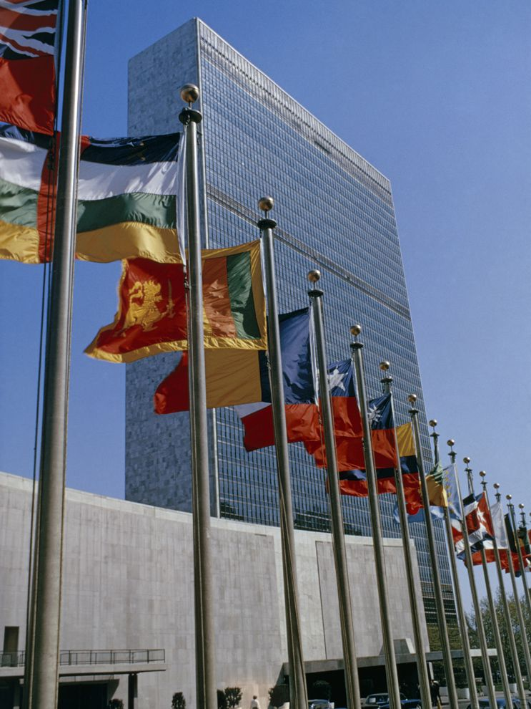
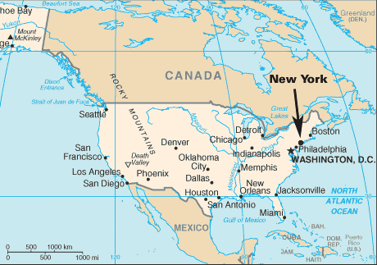
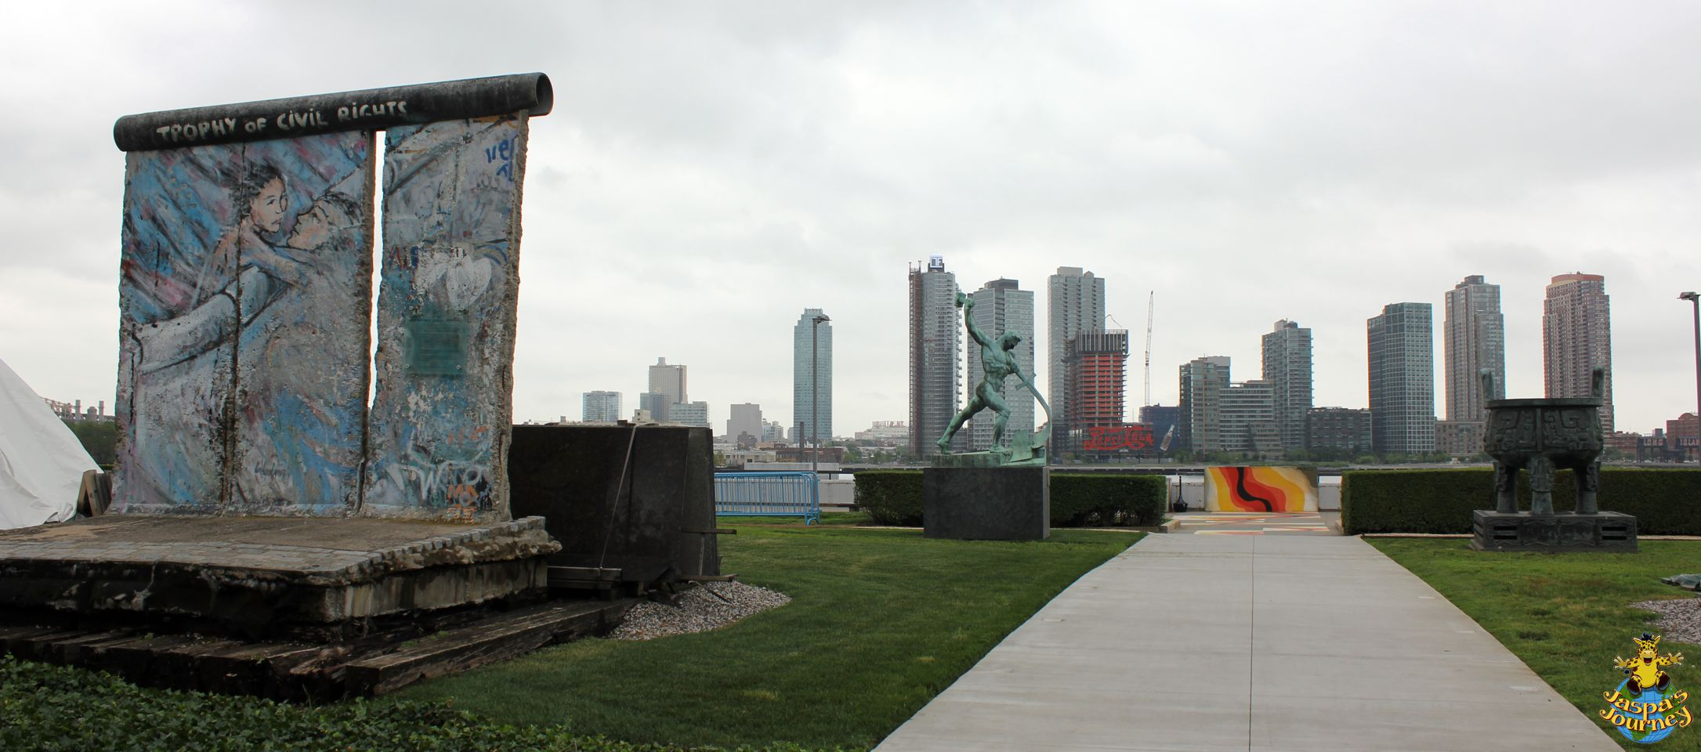
UN HEADQUARTERS NEW YORK
Situated in NYC
Notes:
The United Nations is headquartered in New York City, USA. The is complex has served as the official headquarters of the UN since its completion in 1952. This is where the General Assembly takes place, many commissions occur and is home to the secretariat.

Slide 25
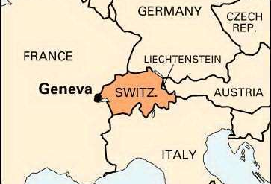
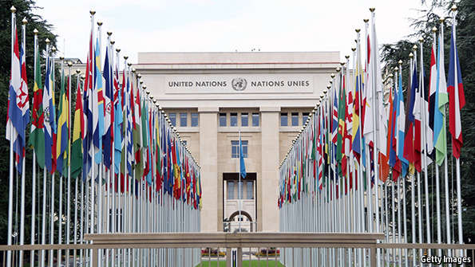
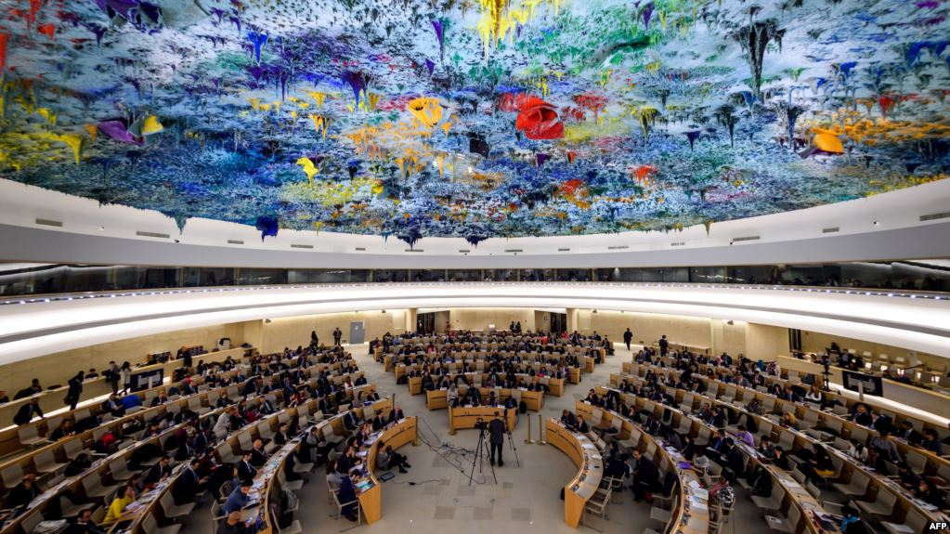
GENEVA
Notes:
The United Nations Office at Geneva (UNOG) is the second-largest of the four major office sites of the UN. It is located in the Palais Des Nations building that was constructed for the League of Nations between 1929 and 1938. This UN office is considered to be the home of Human Rights and holds a number of commissions and meetings annually.

Slide 26
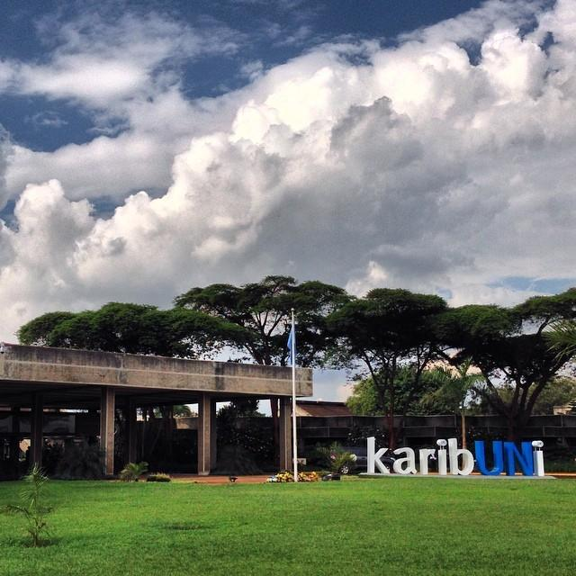
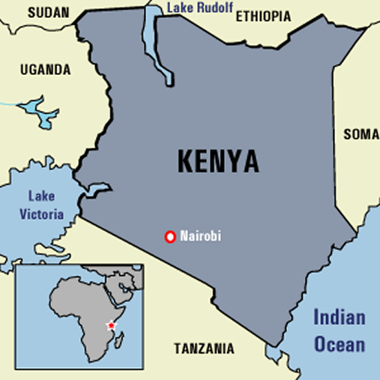
NAI, KENYA
NAIROBI

Slide 27
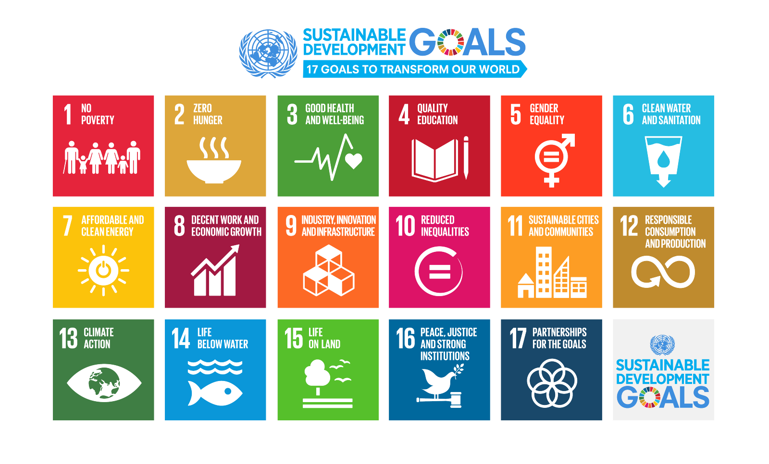
CURRENT UN FOCUS
The 2030 Agenda
For more information on the 17 SDGs, check out this video as well! https://www.youtube.com/watch?v=9-xdy1Jr2eg
Notes:
This video is the one that explains the SDGs, no need to talk to this slide just play the video

Slide 28
SDGS: CROSS-CUTTING & MULTI-DIMENSIONAL
The 17 SDGs cover five critical dimensions,
also known as the 5 P’s:
People (1-7)
Prosperity (8-11)
Planet (12-14)
Peace (16)
Partnerships (17)

Slide 29
PEOPLE: 1-7

Slide 30
PROSPERITY 8-11

Slide 31
PLANET : 12-15

Slide 32
PEACE & PARTNERSHIP : 16-17
Notes:
Each of UNANIMA Internationals focus areas are related to the SDGs, their implementation & achievement. We as civil society play an integral role in the realisation and the achievement of the SDGs. We don’t just work to implement them at the local level but we also have the opportunity to encourage and hold governments accountable in their responsibilities towards achieving them. The SDGs are beginning implemented by 193 countries, 80 of these have UNANIMA International Members in them!
While UNANIMA International certainly contributes to all 17 goals both at the Grassroots and in NYC we do have a particular interest in 7 of the goals. It was decided that these would be our focus after taking stock of the ministeries that UNANIMA members take part in. The SDGs of interest for UNANIMA International are:
1- End Poverty in all its forms everywhere
3- Goog Health and Well Being
4- Quality Education
5- Gender equality
10- Reduced Inequalities
13- Climate action
16- Peace, Justice and Strong Institutions

Slide 33
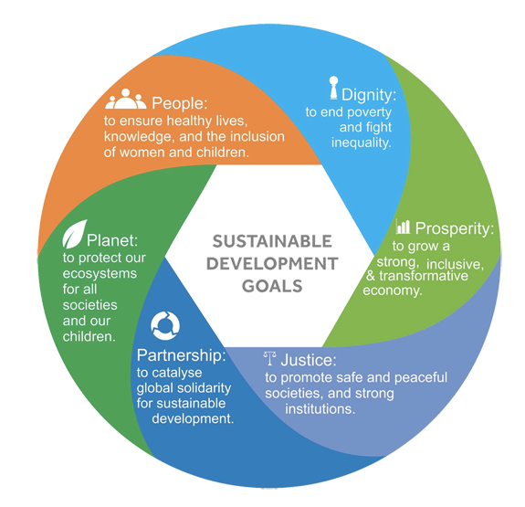
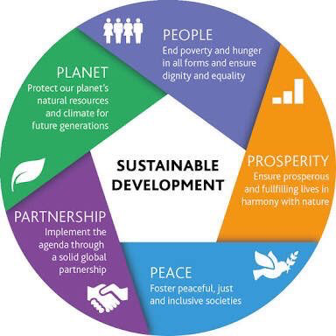
Notes:
The United Nations is trying to achieve the the Sustainable Development Goals through the 5 Ps
People -We are determined to end poverty and hunger, in all their forms and dimensions, and to ensure that all human beings can fulfil their potential in dignity and equality and in a healthy environment.
Planet -We are determined to protect the planet from degradation, including through sustainable consumption and production, sustainably managing its natural resources and taking urgent action on climate change, so that it can support the needs of the present and future generations.
Prosperity - We are determined to ensure that all human beings can enjoy prosperous and fulfilling lives and that economic, social and technological progress occurs in harmony with nature.
Peace - We are determined to foster peaceful, just and inclusive societies which are free from fear and violence. There can be no sustainable development without peace and no peace without sustainable development.
Partnership - We are determined to mobilize the means required to implement this Agenda through a revitalised Global Partnership for Sustainable Development, based on a spirit of strengthened global solidarity, focussed in particular on the needs of the poorest and most vulnerable and with the participation of all countries, all stakeholders and all people.
The interlinkages and integrated nature of the Sustainable Development Goals are of crucial importance in ensuring that the purpose of the new Agenda is realised. If we realize our ambitions across the full extent of the Agenda, the lives of all will be profoundly improved and our world will be transformed for the better.

Slide 34
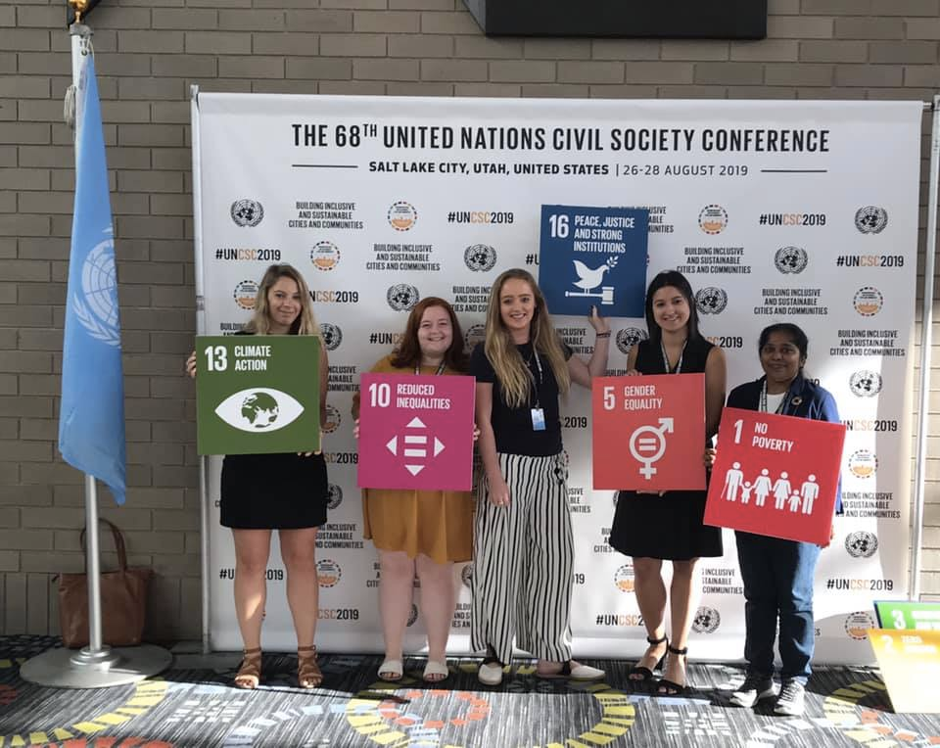
WHO WILL ACHIEVE THE SDGS?
Governments
UN agencies
Academic institutions
Private companies
Labour unions
Children and youth
Indigenous Peoples
Media
Civil society: all people of good will, including women and men Religious and other faith leaders
You, Me, All of Us!

Slide 35
HOW CAN WOMEN & MEN IN RELIGIOUS USE THE SDGS?
Analyse our mission and activities with respect to the SDG framework
Identify the SDGs that are most relevant to our work
Identify the responsible Ministry at the Centre & Department in our State
Identify the schemes and services that our government and our own communities allocate to address these SDGs
Use the monitoring indicators used by the government to measure its progress and our contribution
Share our stories of service and of the unmet needs of those we serve in order to hold our government accountable to their SDG commitment and to offer our advice in helping them fulfill it

Slide 36
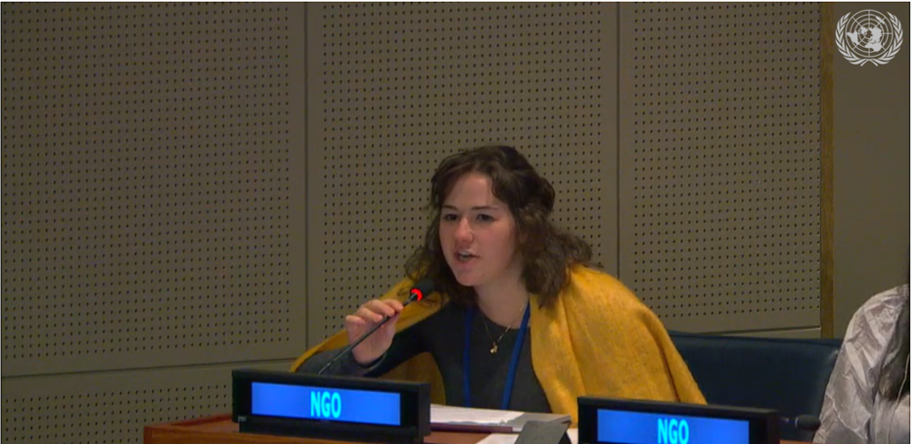
THE ROLE OF NGOS AT THE UN
The UN’s “window to reality” – Ban Ki Moon, former UN SG
The UN’s “conscience” - John Paul II
"Instrumental in shaping our global framework on women’s empowerment” – CSW website
Watchdogs, reminders, teachers, resources, and “boots on the ground”
Notes:
Non-governmental organizations (NGOs) participate vitally in the international system. They contribute valuable information and ideas, advocate effectively for positive change, provide essential operational capacity in emergencies and development efforts, and generally increase the accountability and legitimacy of the global governance process.
The Secretary General has frequently affirmed the importance of NGOs to the United Nations. Again and again, he has referred to NGOs as "indispensable partners" of the UN, whose role is more important than ever in helping the organization to reach its goals. He has affirmed that NGOs are partners in "the process of deliberation and policy formation" as well as in "the execution of policies." Other top UN officials, as well as many delegations, have expressed the same ideas.

Slide 37
RELIGIOUS PRESENCE
among NGOs at the UN
Over 30 NGOs collectively represent over 200 congregations of Catholic women and men Religious
Bring credability by providing insights from members’ work ministering to the poorest and most vulnerable populations “on the ground”
Bring impartiality as most are present in many nations and have no national identity
Bring moral voice as faith-based groups known for a life of dedication to human dignity of all and care of the natural environment

Slide 38
QUESTIONS?

Slide 39
AT THE UN
Notes:
molly

Slide 40
UNANIMA INTERNATIONAL
An NGO (non-governmental organization) coalition committed to the Charter of the United Nations, for the economic and social advancement of all peoples
*In special consultative status with the United Nations Economic and Social Council (ECOSOC)
*Associated with the United Nations Department of Global Communications
* A UNFCCC Accredited Organization
Notes:
At the meeting of the 2000 US Leadership Conference of Women Religious(LCWR), Catherine Ferguson SNJM invited any interested religious congregations to form a coalition NGO to advocate at the United Nations on behalf of women and children. In December 2001 six congregations met to develop a mission statement, budget, and the name, UNANIMA International.
June 2002 marked the official corporate beginning of the non-profit organization incorporated in the state of New York. At the meeting in September 2002 the board chose a two-year focus, accepted the Bylaws, chose a logo, and reviewed the first website.
UNANIMA International received Department of Global communications Status (Fomerly DPI) in the fall of 2004. We then received ECOSOC Special Consultative Status on the 21st of July 2005

Slide 41
UNANIMA INTERNATIONAL’S ACCREDITATIONS
ECOSOC Special Consultative Status
Consultative status provides NGOs with access to not only ECOSOC, but also to its many subsidiary bodies, to the various human rights mechanisms of the United Nations, ad-hoc processes on small arms, as well as special events organized by the President of the General Assembly. See News and Events for samples. It is they way in which we give Information to the UN.
Department of Global Communications Accreditation
The accreditation signifies our relationship with the DGC. This mandate is to develop partnerships with civil society around the world to enhance their interaction with and understanding of the work of the Organization. The provide us with resources and information on the UN that we share with our grassroots.
United Nations Framework Convention on Climate Change (UNFCCC)
NGOs that are accredited by UNFCCC are able to register and participate in the COP meetings as follow up and implementation of the Paris Agreement. A limited number of civil society organizations have this accreditation and access for participation in the conference.

Slide 42
WHAT DOES IT MEAN TO BE ACCREDITED?
Accreditation allows NGOs to participate in UN proceedings by:
Making oral statements
Submitting written statements
Sponsoring events inside and near UN Headquarters
Meeting with diplomats
Attending UN conferences
Making formal or informal recommendations on new UN declarations and resolutions as they are being negotiated
Submitting reports and comments to national review processes (e.g. Voluntary National Reviews on SDGs, Universal Periodic
Review at Human Rights Council

Slide 43
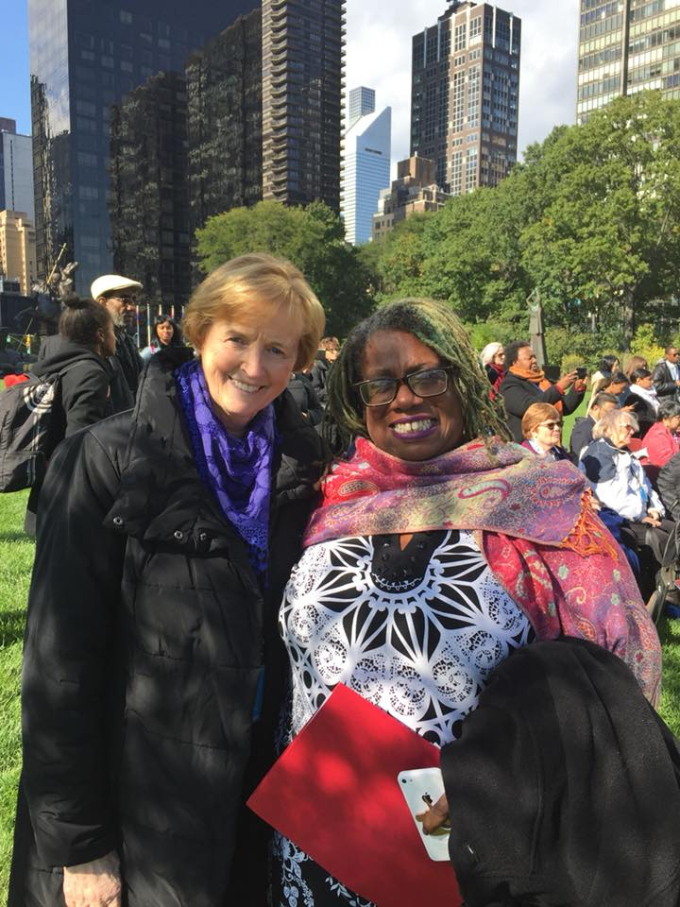
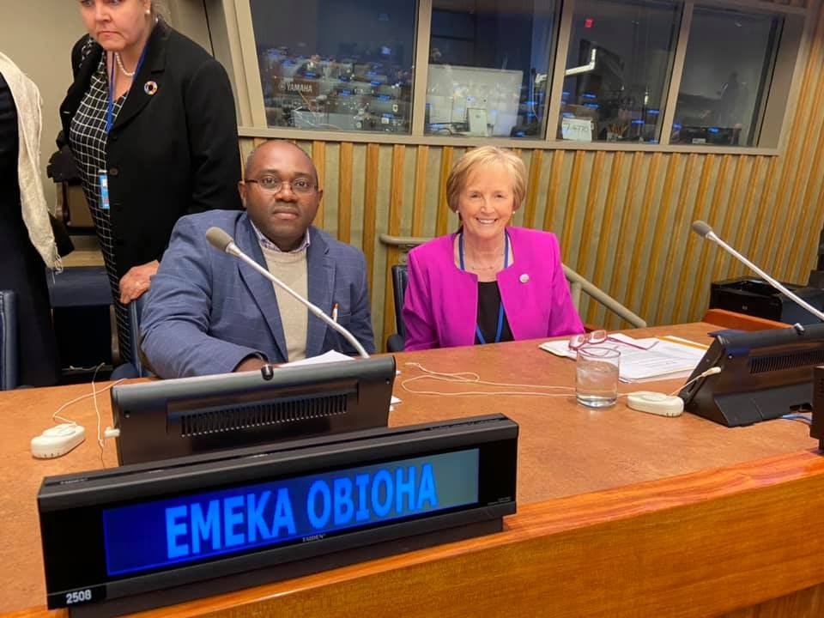
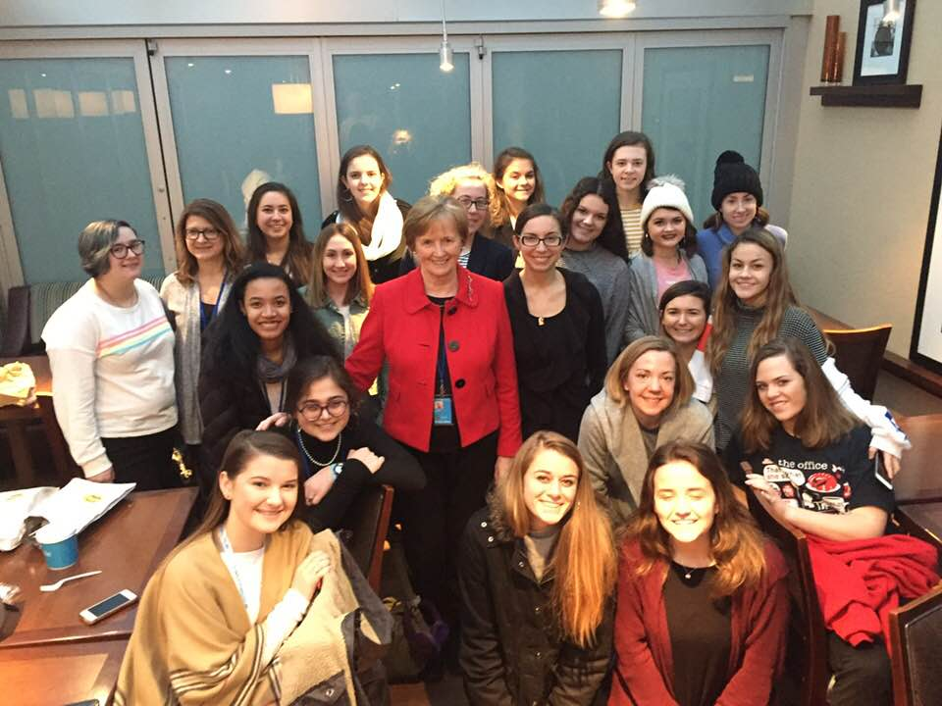
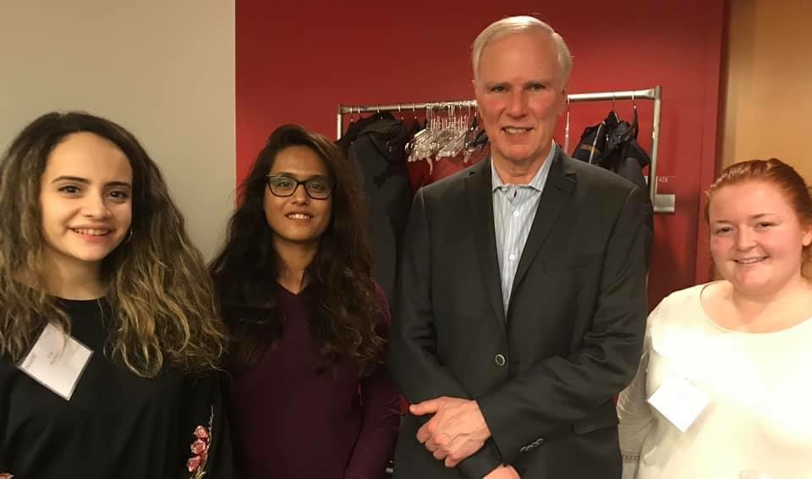
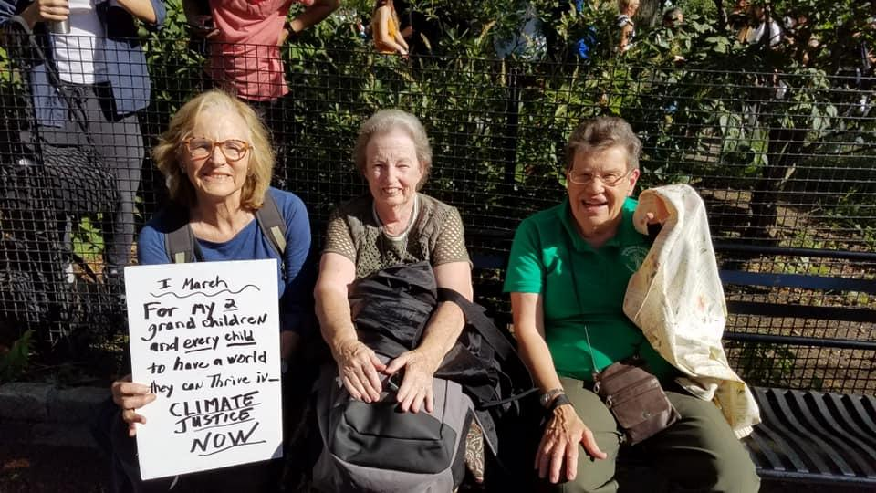
AT THE UN
Notes:
Pictured
Making interventions at official UN Commissions, Meetings and Events
Meeting with Students CSW- Attending Commissions
International Day for the Eradication of Poverty- Planning and participating in events
NYC Rally- Advocating through Collective Action

Slide 44
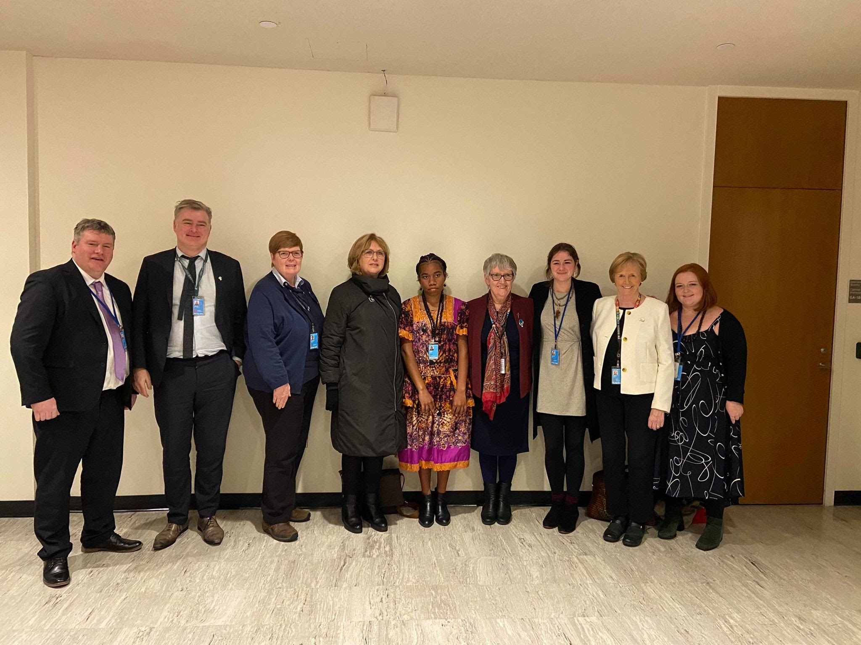
WHAT DO WE DO?
To bring members’ expertise to UN
To work with other NGOs
Contribute to NGO Committees and Working Groups
To educate our members about the activities and programs of the UN
Make interventions
Attend Events, Commissions and UN Activities
To assist our members in collaborating with UN work in their home countries
Share our research with Partners, UN Officials and other Advocates
Notes:
Picture of HLPF Side event bringing grassroots voices to the UN.

Slide 45
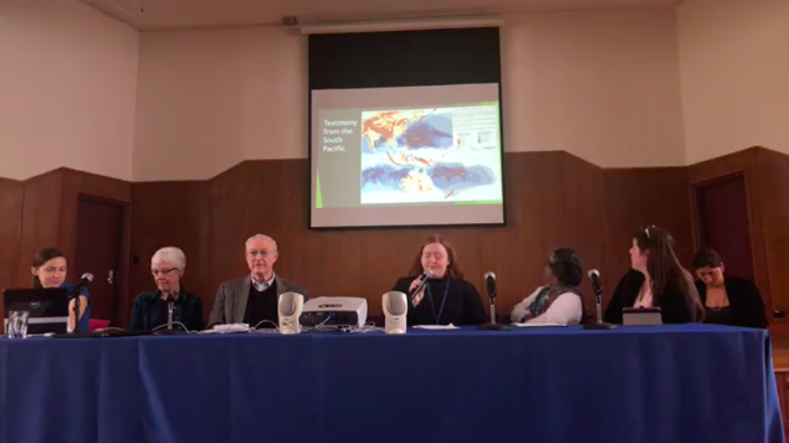
SOME NGO WORKING GROUPS WE CONTRIBUTE TO
NGO Committee on Social Development
Grassroots Subcommittee
Advocacy Subcommittee
Committee on Migration
Xenophobia Subcommittee
Climate Induced Migration Subcommittee
Working Group on Ending Homelessness
NGO Major Group
NGO Habitat
Notes:
The NGO Committee on Social Development is a coalition of organizations dedicated to working towards people-centered social change and development through the United Nations.
The mission of the NGO Committee on Migration (CoM) is to encourage the protection and promotion of migrants’ human rights in accordance with the United Nations Charter.
Mission for WGEH still under construction!! Add
The NGO Major Group is tasked with facilitating the participation and enhancing the engagement of non-governmental organizations in the processes directly and indirectly related to the High Level Political Forum. When possible, we work to organize positions on behalf of the members to be delivered in various United Nations spaces.
Cannot find the mission for NGO Habitat However, Habitat III offered a unique opportunity to discuss the important challenges of how cities, towns, and village can be planned and managed, in order to fulfill their role as drivers of sustainable development, and how they can shape the implementation of the Sustainable Development Goals and the Paris Agreement on climate change. I assume NGO Habitat is the civil society contributor to this.

Slide 46
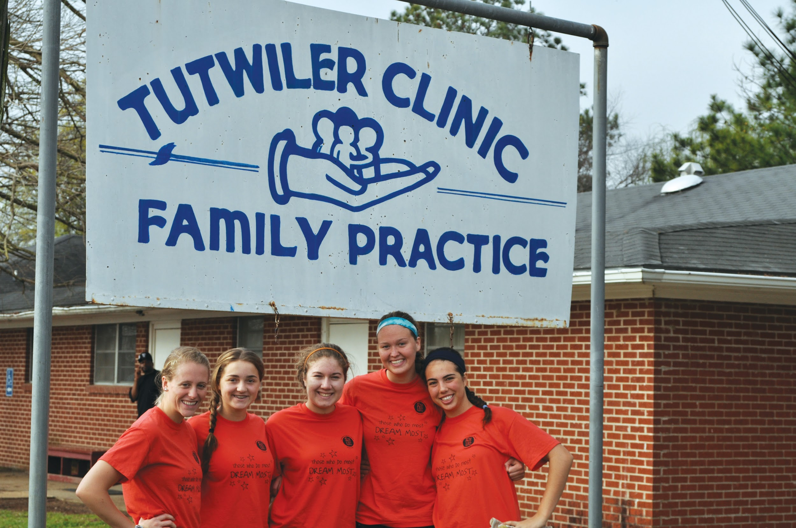
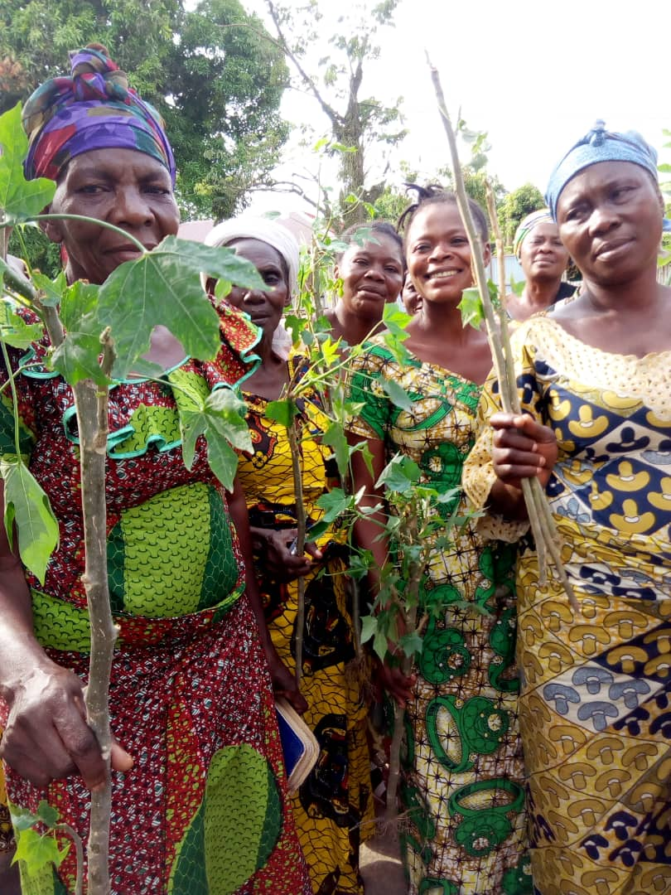
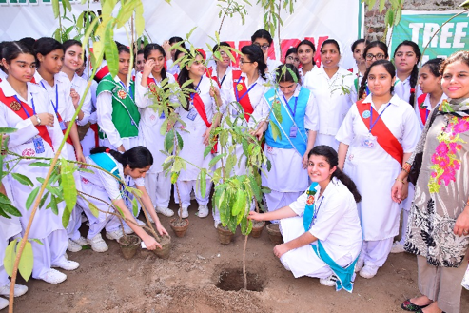
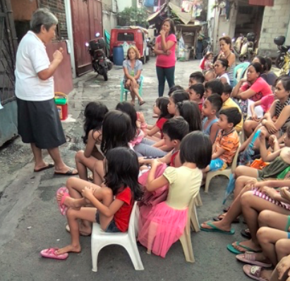
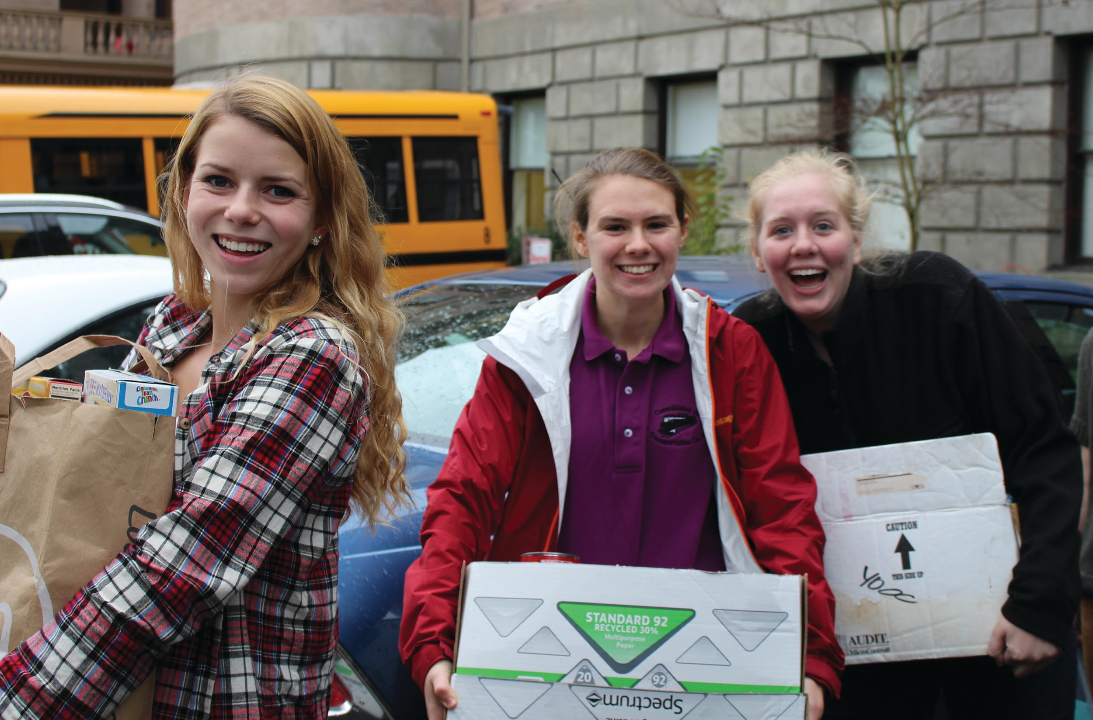
GLOBAL ACTIVITIES
Notes:
Pictures of our members contributing to grassroots initiatives and advocacy at the local level

Slide 47
MAPPING OUR PRESENCE AT THE UN
Public Opinion and Social Policy
International “Boomerang” Advocacy
Local/ National/ Regional Level International Level
Direct Advocacy Grassroots
Mobilize and Raise Awareness with Others (Connect!!)
Monitor and Gather Information
Choose or Clarify Your Focus
From Passion to Product
NGO
Notes:
Explanation of Passion to Product Diagram

Slide 48
INTERNATIONAL FRAMEWORKS UNANIMA INTERNATIONAL WORKS TO
The 2030 Agenda
Universal Declaration of Human Rights
Conventions on the Rights of the Child
Istanbul Declaration on Human Settlements
The Paris Agreement
Global Compact on Migration
Global Compact on Refugees
The New Urban Agenda
Convention on the Elimination of all Forms of Discrimination against Women (CEDAW)
The international Covenant on Economic, Social and Cultural Rights
Declaration on the Rights of Indigenous Peoples
+ many more

Slide 49
AREAS OF FOCUS

Slide 50
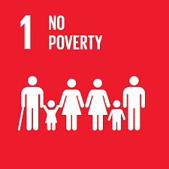
WOMEN AND CHILDREN
Women and Children, everywhere, must have equal rights and opportunity, and be able to live free of violence and discrimination.
Women and Children (especially those living in economic poverty) are often those left furthest behind
Are connected to each of the 17 SDGs
Women specifically have their “own” goal to promote Gender Equality (Goal 5)
There are numerous indicators for the SDGs which relate specifically to Children
Notes:
It is said ‘Women hold up half the sky.’ Unfortunately this is not often reflected in the way it should be, especially from and economic perspective. Biggest structural barriers to women’s economic empowerment is women’s disproportionate burden of unpaid care and domestic work at home. It restricts them from pursuing education, skills training and taking up paid jobs. According to UNDP report on Gender Equality, it is estimated that unpaid care work undertaken by women today “amounts to as much as $10 trillion of output per year, roughly equivalent to 13% of global GDP.” Besides the economic exclusion, women are subjected to social, cultural and traditional practices like patriarchy that confines them to their homes. Women are not only more affected by these problems, but also possess ideas and leadership to solve them. The gender discrimination is still holding too many women back, this in turn holds our world back. This is why gender equality has a specific goal.
Like Women, Children and Youth are often among the ones left furthest behind. While children do not have a specific goal dedicated to them they are equally important to the SDGs. As populations grow and the number of children and youth rise it is integral that their needs are addressed and they actively participate in the implementation and achievement of the 2030 agenda. Throughout the 17 goals children and youth are named in a number of the indicators.

Slide 51
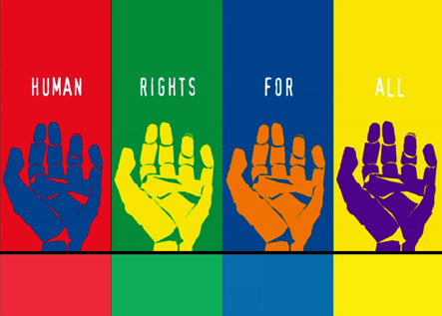
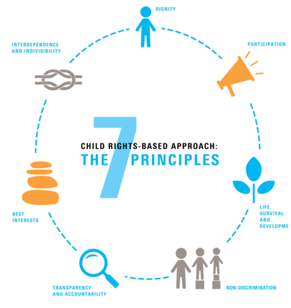
HUMAN RIGHTS
More than 90 % of the Sustainable Development Goals (SDGs) targets are linked to international Human Rights
Agenda highlights that Sustainable Development must be at the service of Human Dignity
Human rights offer guidance for the implementation of the 2030 Agenda for Sustainable Development
high degree of convergence between human rights and the 2030 Agenda for Sustainable Development (the SDGs)
We need to take a Human Rights Based Approach
Notes:
The 2030 Agenda highlights that Sustainable Development must be at the service of Human Dignity, for development of the whole person. This is reflected in its focus to eradicate poverty and hunger to ensure a life of dignity to all people living in poverty. It is further upheld in the human rights language used in framing the goals and targets and the call to implement them from a rights-based approach. Human rights offer guidance for the implementation of the 2030 Agenda for Sustainable Development. Likewise, the 2030 Agenda and the SDGs can contribute substantially to the realisation of human rights.
The high degree of convergence between human rights and the 2030 Agenda for Sustainable Development implies that existing human rights mechanisms can directly assess and guide the implementation of the 2030 Agenda and its SDGs. Moreover, drawing on existing human rights mechanisms will ease the reporting burden of states, and enhance coherence, efficiency and accountability. Therefore a human rights based approach the the SDGs in integral.
The human rights based approach stipulates that:
Development should further the realisation of human rights;
Human rights standards should guide development cooperation and programming; and
Development cooperation contributes to the development of capacities of duty-bearers to meet their obligations and of rights-holders to claim their rights.

Slide 52
CLIMATE
God Gave us the Earth to till and to Keep in a Balanced and Respectful way - Pope Francis
Climate change is now affecting every country on every continent. It is disrupting national economies and affecting lives, costing people, communities and countries dearly today and even more tomorrow.
To strengthen the global response to the threat of climate change, countries adopted the Paris Agreement at the COP21 in Paris, which went into force in November of 2016.
Relates to all the goals, specifically Goal 13.
If climate action is not taken, the implications of climate change will not allow for any of the 17 goals to be achieved.
Notes:
Climate Change is real and it is impacting people everywhere. Experiences of extreme droughts, floods, hurricanes, forest fires, rising sea-levels, etc., by people in this country and around the world will validate it. The IPCC Report of 2018 lays out the urgency needed to reduce greenhouse gas emissions to limit global warming to 1.5-degree Celsius. This wake-up call was ignored by the 197 countries who gathered in Katowice, Poland in December 2018 for COP 24. The governments demonstrated their moral failure and unwillingness to create a Climate Just Pathway – directions and guidelines to implement Paris Climate agreement, which comes into force 2020. Climate has a specific Goal goal in the 2030 Agenda, Goal 13- Urgent Climate Action. Of course climate is connected to all of the SDGs and without a healthy planet we cannot achieve any of the other goals.

Slide 53
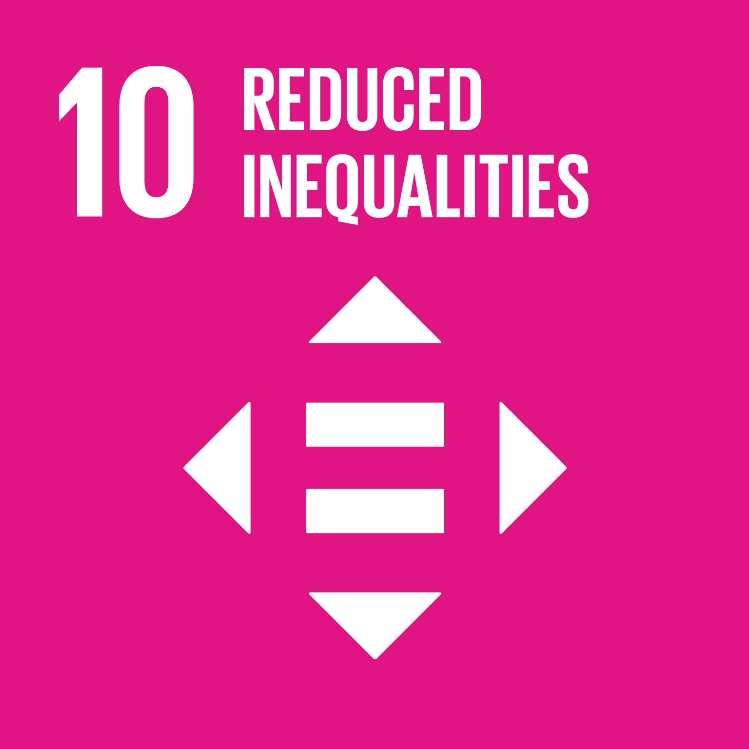
MIGRANT & REFUGEES
“We have become not a melting pot but a beautiful mosaic. Different people, different beliefs, different yearnings, different hopes, different dreams.” - Jimmy Carter
The number of Migrants and Refugees continues to grow globally
Migrants and Refugees are not just those displaced from a country but also those people experiencing displacement within a country
The SDGs cannot be achieved without taking into account the rights and needs of Refugees and Migrants
Target 10.7 - Facilitate orderly, safe, regular and responsible migration and mobility of people, including through the implementation of planned and well-managed migration policies
Notes:
Migration is one of the defining features of the 21st century. It contributes significantly to all aspects of economic and social development everywhere. The SDGs cannot be achieved without taking into account the rights and needs of refugees, internally displaced and stateless people.
Migration can be both negative and positive to development, and though the relationship between the two is increasingly recognised, it remains under-explored. If we want the 2030 Agenda and the SDGs to be achieved we must ensure migration contributes to positive development outcomes. To do this, we need to understand the impact of migration on the achievement of all SDGs, and – equally – the impact this achievement will have on future migration patterns.
While all 17 goals relate to migrants and refugees target 10.7 directly addresses the Facilitation of orderly, safe, regular and responsible migration and mobility of people, including through the implementation of planned and well-managed migration policies
Recently the Global compact for Refugee and the Global Compact for Migration have been established. UNANIMA International was involved in advocacy efforts during their creation through the NGO Committee on Migration. At present we are advoaction for their successful implementation globally.

Slide 54
HLPF is held every year to review the Sustainable Developmnt Goals and allow countries to present a Voluntary Report (Voluntary National Review, VNR) on Progress, in their country.
This year, it’s 5th year (2020), the HLPF will take a slightly different approach in reviewing the SDGs and review of them in the context of the theme rather than a group of the goals
In July under the auspices of the Economic and Social Council the SDGs will be reviewed under the theme.
"Accelerated action and transformative pathways: realizing the decade of action and delivery for sustainable development ".
In 2020 convened under the auspices of the Economic and Social Council, will be held from Tuesday, 7 July, to Thursday, 16 July 2020, including the three-day ministerial meeting of the forum from Tuesday, 14 July, to Thursday, 16 July 2020.
Notes:
Initiated in July 2016, a special meeting called a High-Level Political Forum (HLPF), is held every year to review specific Goals and allow countries to present a Voluntary Report on Progress, in their country. The HLPF is the main mechanism for review of the goals at the United Nations.
Molly finish
This year, it’s 5th year (2020), the HLPF will take a slightly different approach in reviewing the SDGs and review of them in the context of the theme rather than a group of the goals
In July under the auspices of the Economic and Social Council the SDGs will be reviewed under the theme.
"Accelerated action and transformative pathways: realizing the decade of action and delivery for sustainable development ".
In 2020 convened under the auspices of the Economic and Social Council, will be held from Tuesday, 7 July, to Thursday, 16 July 2020, including the three-day ministerial meeting of the forum from Tuesday, 14 July, to Thursday, 16 July 2020.

Slide 55
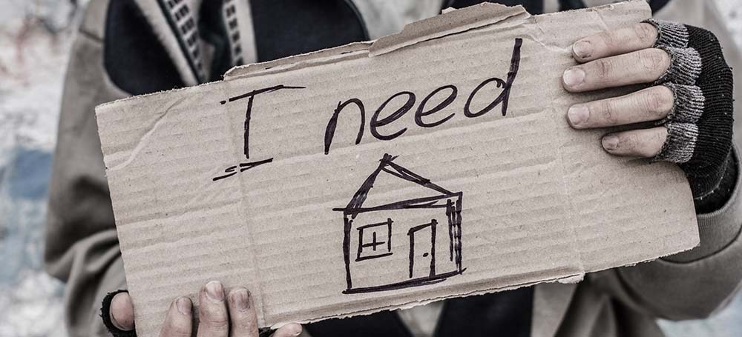
HOMELESSNESS
150 Million People 2% of the world’s population are homeless
1.6 Billion People - + 20% lack adequate housing
Homelessness is complex and manifests itself in different forms depending on the context. Is one of the manifestations of this inequality. Levels of homelessness have dramatically risen in most major cities in the world. It can be both visible and hidden across developed and developing nations.
Notes:
Is one of the manifestations of this inequality. Levels of homelessness have dramatically risen in most major cities in the world.
· 150 Million People – 2% of the world’s population are homeless (National Reports)
· 1.6 Billion People - + 20% lack adequate housing
Homelessness is complex and manifests itself in different forms depending on the context. It can be visible – where people live on the streets or invisible where women/ children/ girls will not be seen

Slide 56
A GLOBAL PICTURE OF HOMELESSNESS
Data and Measurement are Vital to Addressing the Issue!!
Homelessness is affecting every country globally
Homelessness is on the rise globally
National definitions of homelessness vary
There was no global definition
Difficult to make a cross-country comparison
Lack of qualitative and quantitative data globally
There are many types of homelessness
There are many drivers of homelessness
Various policies to address and prevent homelessness have been implemented with varying success globally
The word homelessness is sparse across UN language and documents
Notes:
There has been a significant increase in the numbers of people living in homelessness in many countries in the past 7 years.
· Each country defines homelessness differently
· Difficult to make a cross-country comparison
· Stems from the lack of a Universal definition of “homelessness”
· Need at this meeting to come up with a common definition to move the agenda forward
· Data and measurement are vital to address this issue, it enables evidence-based analysis and policy making at the national and local levels
Until the Expert Group meeting that convined in Nairobi, Kenya in May 2019 there was no global definition of homelessness. There was a need for this meeting to come up with a common definition to move the agenda forward!
· 1.6 billion Live in inadequate housing conditions
· 22 million displaced in average per year due to climate related events
There was a need for the definition to be framed within the 2030 Agenda and in particular with the overarching principle of “no one left behind” and to reach the furthest left behind first”

Slide 57
THE UN & HOMELESSNESS
In 2017/2018 group of NGOs came together to address the issue of homelessness and bring it to the attention of the UN. The Working Group to End Homelessness (WGEH) was formed.
The working group put together a significant advocacy campaign making effort to push the issue of homelessness at every opportunity.
Advocacy by the WGEH and friendly member states at the 57th Commission for Social Development (CSocD57) lead to “Affordable housing and social protection systems for all to address homelessness.” being adopted as the CSocD58 priority theme.
An Expert Group Meeting on the topic of Homelessness was convened in Nairobi, Kenya in May 2019 in preparation for the 58th Commission for Social Development
The WGEH and NGO CSocD came together in preparation for CSocD58
The 58th Commission for Social Development
General Assembly Resolution
Notes:
Policy recommendations
The 2030 Agenda and UN Human Rights Instruments / Legal Framework
Recognize the commitment made to achieve the goals especially “leave no one behind” and ‘reach the furthest left behind’
SDG1.3
SDG 11.1 and other related goals
Universal Declaration of Human Rights
Conventions on the Rights of the Child
Convention on the Elimination of all Forms of Discrimination against Women (CEDAW) among others

Slide 58
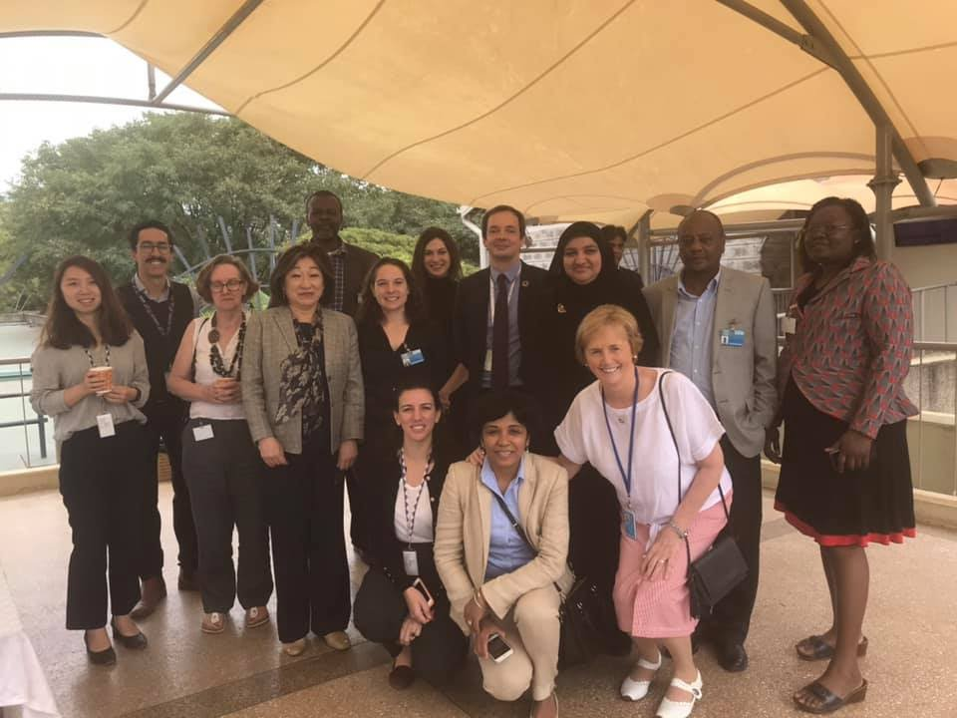
EXPERT GROUP MEETING
Held in preparation for the 58th Commission for Social Development
Convened in Nairobi, Kenya in May 2019
Jean Quinn was invited to attend as an expert she
Discussed several topics in the context of Homelessness
Drivers
Type of homelessness
Homelessness in different economic, social and geographic contexts
Solutions
Proposed a global definition of Homelessness

Slide 59
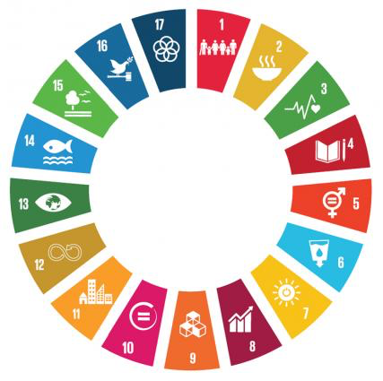
THE EXPERT DEFINITION
Coming together the Expert decided the definition should be:
Be Inclusive
Be politically sensitive
Ensure Homelessness is seen a societal failure not a personal one
Needs to be framed within the 2030 Agenda and in particular with the overarching principle of “no one left behind” and to reach the furthest left behind first
Should be measurable

Slide 60
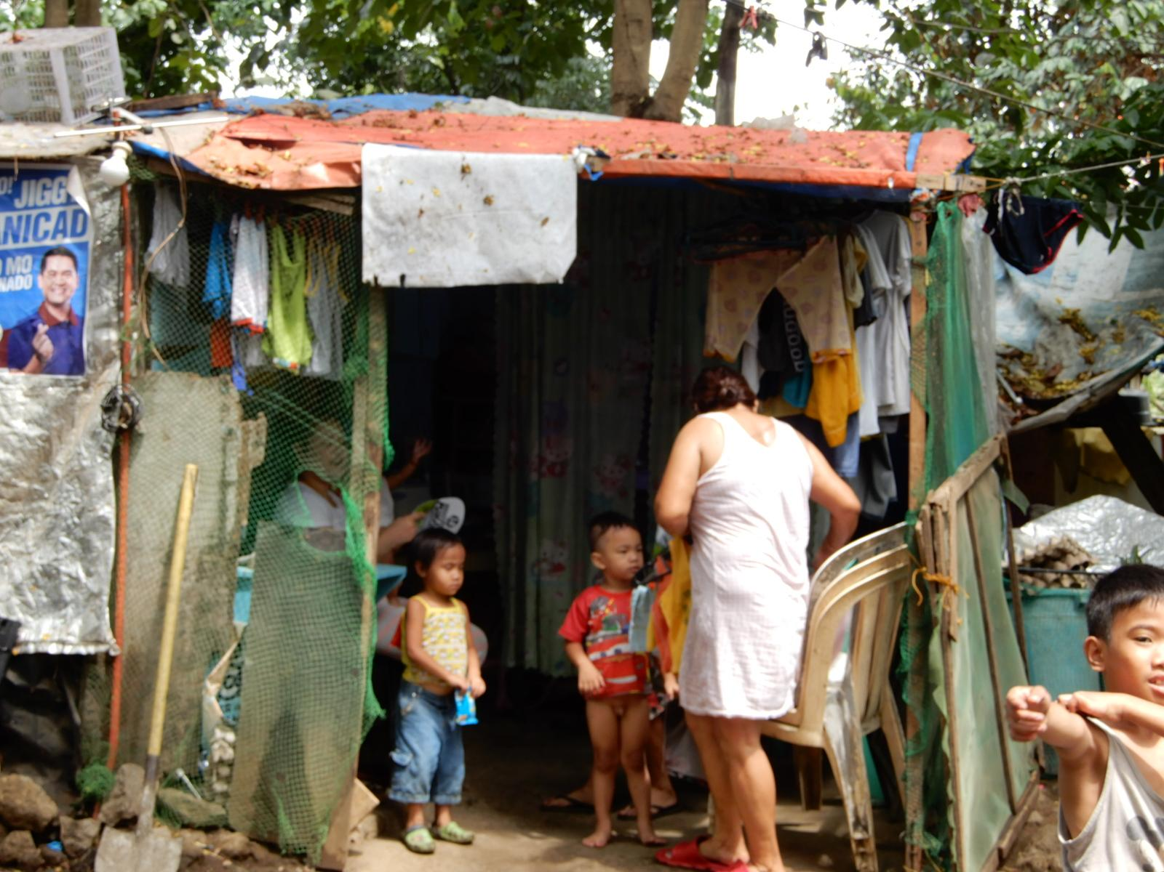
EXPERT GROUP PROPOSED DEFINITION
“Homelessness is a condition where a person or household lacks habitable space with security of tenure, rights and ability to enjoy social relations, including safety. Homelessness is a manifestation of extreme poverty and a failure of multiple systems and human rights”
In defining homelessness, it would include the following four categories of people:
People living on the streets or other open spaces
People living in temporary or crisis accommodation
People living in severely inadequate and insecure accommodation
People lack access to affordable housing
Notes:
The expert group proposed to define homelessness as:
“Homelessness is a condition where a person or household lacks habitable space with security of tenure, rights and ability to enjoy social relations, including safety. Homelessness is a manifestation of extreme poverty and a failure of multiple systems and human rights”
In defining homelessness, it would include the following four categories of people:
People living on the streets or other open spaces
People living in temporary or crisis accommodation
People living in severely inadequate and insecure accommodation
People lack access to affordable housing

Slide 61
QUESTIONS?

Slide 62
ADVOCACY + RESEARCH

Slide 63
WHAT IS ADVOCACY
Advocacy- The public support for an idea, plan, or way of doing something
-Cambridge Dictionary Online
“Any action that speaks in favor of, recommends, argues for a cause, supports or defends, or pleads on behalf of others.”
-Alliance for Justice
How does UNANIMA International do it so well?
Advocacy from the Grassroots and the UN

Slide 64
UNANIMA INTERNETIONAL & FAMILY HOMELESSNESS
We heard the call from our Members, Women and Children Globally, for the growing issue of Family Homelessness to be addressed…
Since 2018 we have put time and resources into advocacy through research on the issue of Family Homelessness & Trauma…
We share our research; educating and advocate with conviction & reliability, becoming know as experts on the issue

Slide 65
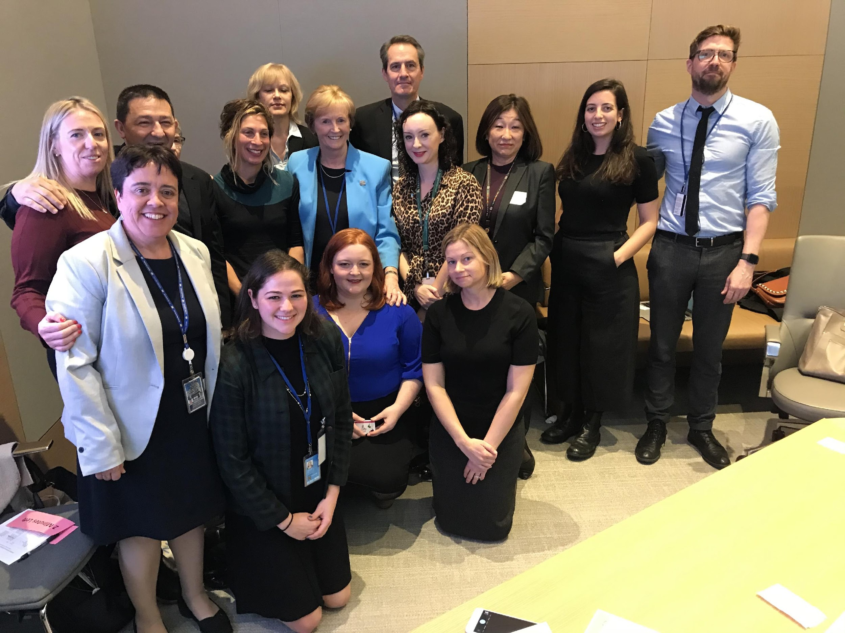
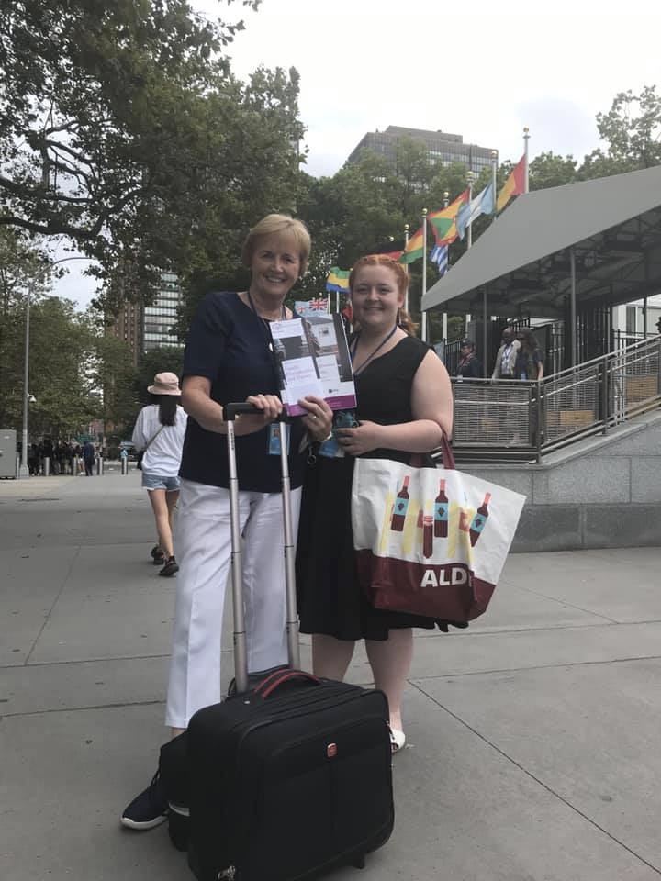
HOW DOES UNANIMA INTERNATIONAL ADVOCATE TO END HOMELESSNESS?
UNANIMA International has a special focus on Family Homelessness and Trauma. Families, specifically women and children are often considered the Hidden Homeless and therefore often left furthest behind. We advocate for them in a number of ways
Research
Direct Advocacy
Networking
Partnerships
Events

Slide 66
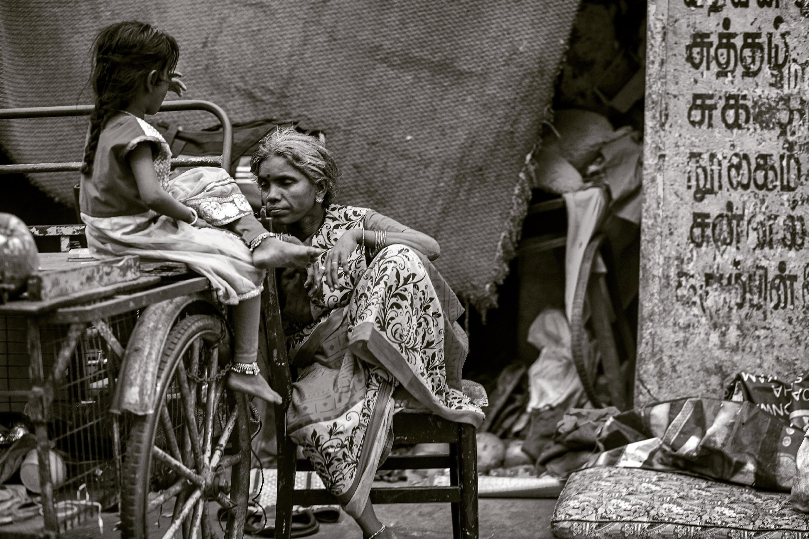
MAIN POINTS OF ADVOCACY
That the voices of Women and Children with a lived experience be heard and including in the conversation and addressing of the issue
For UN Member State to adhere and act on the commitments they have made including but not limited to the 2030 agenda, the Human Rights Declaration etc.
Gender and Family sensitive policies
Housing First with Supports
A paradigm shift to where homelessness is viewed as what it is a human and civil rights issue
Notes:
Policy recommendations
The 2030 Agenda and UN Human Rights Instruments / Legal Framework
Recognize the commitment made to achieve the goals especially “leave no one behind” and ‘reach the furthest left behind’
SDG1.3
SDG 11.1 and other related goals
Universal Declaration of Human Rights
Conventions on the Rights of the Child
Convention on the Elimination of all Forms of Discrimination against Women (CEDAW) among others

Slide 67
FACETS OF THE RESEARCH
Partnerships:
SOPHIA
NYU
UNANIMA International Board
Expert Knowledge:
Academics
Service Practitioners
United Nations
Lived Experience:
Interviews
Focus-Groups
Written Testimonies
Art Submissions
Other Methodology:
Observations
Informal Conversations
Survey for service providers
Quantitative Analysis

Slide 68
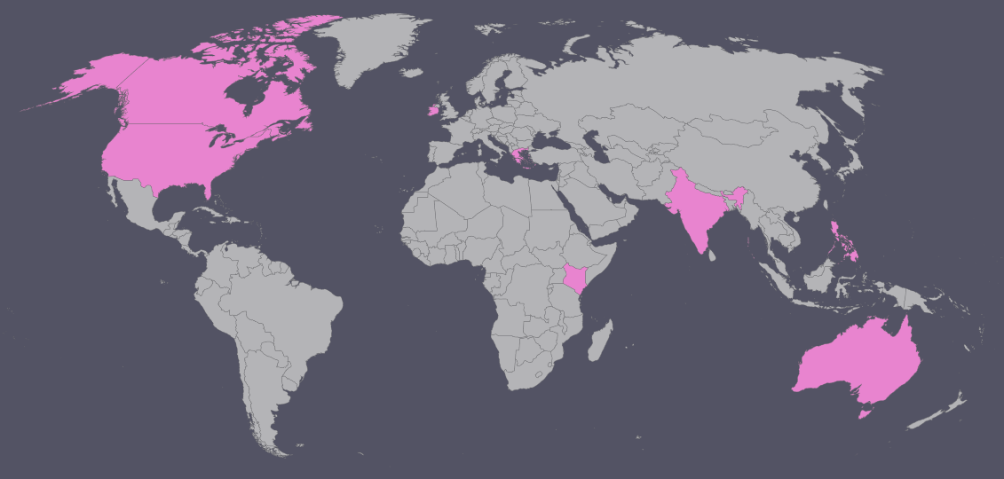
METHODOLOGY & FOCUS REGIONS
Focused on 5 Diverse Geographic, Economic, and Social Regions
• Africa (Kenya)
• Asia (India, Philippines)
• Oceania (Australia)
• Europe (Ireland, Greece)
• North America (USA, Canada)
Theoretical Lenses used for the Analyses include intersectional, social justice, constructivist, and gender; the methodology reflects these.
A mixture of both qualitative and quantitative methodologies have been used to achieve a holistic overview of the topic and ensure outcomes that are not limited to economic and social contexts.
Notes:
Theoretical Lenses used for the Analyses include intersectional, social justice, constructivist, and gender; the methodology reflects these. UNANIMA International’s initial research has focused on five diverse geographic regions and case studies within them. The pilot regions and countries included: • Africa (Kenya) • Asia (India, Philippines) • Oceania (Australia) • Europe (Ireland, Greece) • North America (USA, Canada) A mixture of both qualitative and quantitative methodologies have been used to achieve a holistic overview of the topic and ensure outcomes that are not limited to particular economic and social contexts. Literature reviews (some of which were/are conducted collaboratively with New York University (NYU) capstone master’s students) and existing quantitative data are supported and challenged by our qualitative data collection within the countries profiled. Empirical evidence assists in displaying the wide range of contexts and experiences which comprise Family Homelessness. Qualitative data includes semi-structured interviews with NGOs, service providers, and experts; indispensably, women and families experiencing homelessness and housing insecurity have willingly shared their voices. Testimonies have been derived from interviews and focus groups.

Slide 69
INTENDED OUTCOMES
Identification of good practices in how to serve and engage homeless, formerly homeless, and at risk Families (Women and Children/Girls) to be shared with service providers, including government agencies, policy makers and NGOs
Documentation of lived experiences to be shared within the United Nations system and for educational campaigns
A preliminary analysis of Family Homelessness testimonies, literature, and data, to be organized thematically according to the UN AGENDA 2030 Sustainable Development Goals (SDGs) Initiation of a paradigm shift
Initiation of a paradigm shift
Data estimates for Family Homelessness in country cases

Slide 70
ADVOCACY ACTIONS
Bringing individuals with a lived experience to the United Nations
Networking and sharing research with thematic experts, United Nations departments, Member States and other decision makers
UNANIMA International has launched 3 publications on the topic of Family Homelessness. These publications include the elements of good practices and qualitative testimonies of lived experience.
Distribution of publications and resources to NGOs and UN Member States strategically at CSocD58, the 2019 HLPF and other events.
UNANIMA International’s research is cited and shared by UNANIMA International staff and several notable supporters including Former Irish President Mary McAleese across several speaking events, not limited to NGO side-events and panels, high level panels, and an oral statement before the assembly.
Educational events and advocacy actions at the United Nations community and beyond for religious organizations and educational institutions, have aided in initiating a paradigm shift for homelessness to be viewed as a civil rights and human rights issue.
Social media activity including sharing of publication content, speaking events, news coverage, and other research findings, has bolstered the spread concern for Family Homelessness and attention to our work.
Notes:
Bringing individuals with a lived experience to the United Nations
Networking and sharing research with thematic experts, United Nations departments, Member States and other decision makers
Since initiating the research in mid 2018 UNANIMA International has launched 3 publications on the topic of Family Homelessness. These publications include the elements of good practices and qualitative testimonies of lived experience.
Publications and resources were distributed to NGOs and UN Member States strategically at CSocD58, the 2019 HLPF and other events.
UNANIMA International’s research is cited and shared by UNANIMA International staff and several notable supporters including Former Irish President Mary McAleese across several speaking events, not limited to NGO side-events and panels, high level panels, and an oral statement before the assembly.
Educational events and advocacy actions at the United Nations community and beyond for religious organizations and educational institutions, have aided in initiating a paradigm shift for homelessness to be viewed as a civil rights and human rights issue.
Social media activity including sharing of publication content, speaking events, news coverage, and other research findings, has bolstered the spread concern for Family Homelessness and attention to our work.

Slide 71
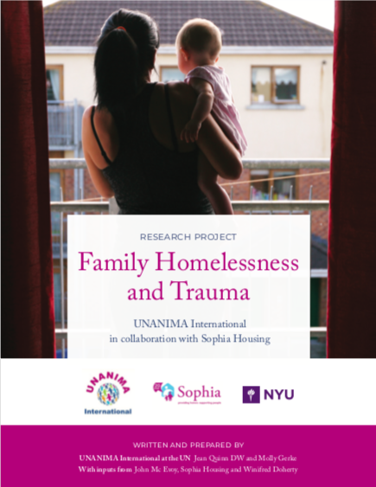
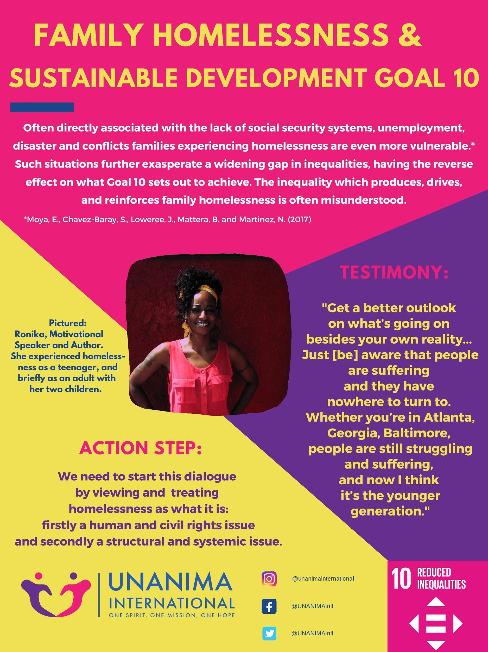
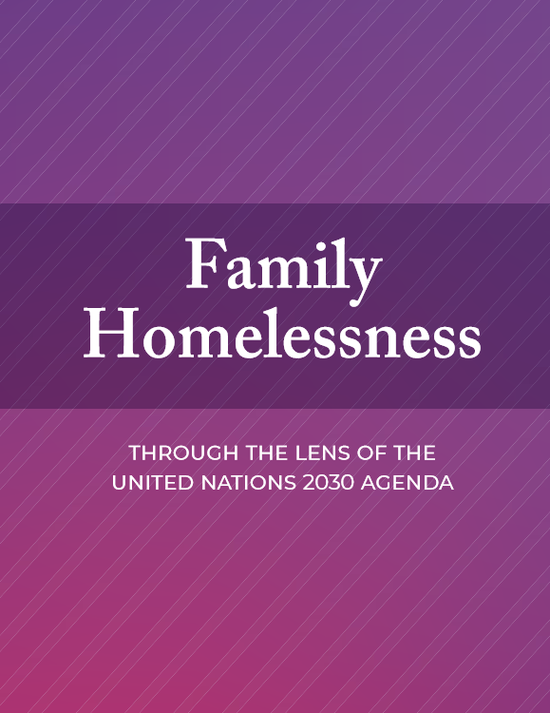
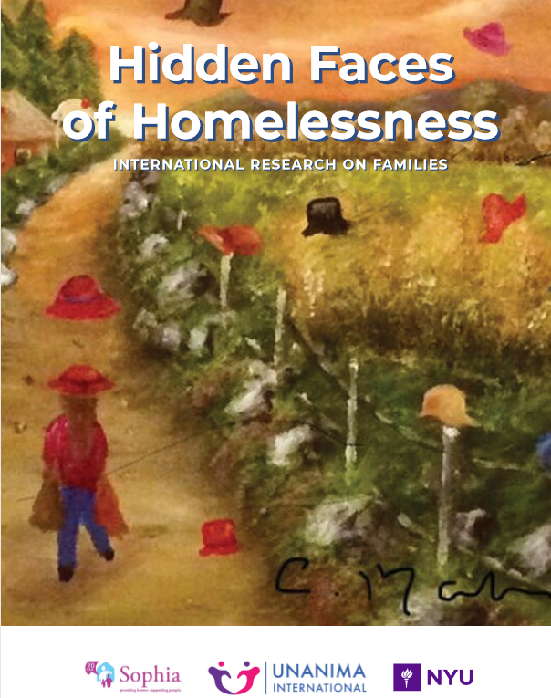
RESOURCES & PUBLICATIONS SO FAR..

Slide 72
58TH COMMISSION FOR SOCIAL DEVELOPMENT (CSOCD58)
“Affordable housing and social protection systems for all to address homelessness”
UNANIMA International Spoke at 12 Event
UNANIMA International is holding or Co-Sponsoring a total of 15 Events
Total of 28 Delegates
Presenting an Oral and Written Statements
Presenting our Research
The launch of 2 publications
Family Homelessness through the Lens of the 2030 Agenda
Hidden Faces of Homelessness International Research on Families
Woman of Courage 2019 Event with Former President of Ireland Mary McAleese
Notes:
The 58th Commission for Social Development (CSocD58) took place from 10 to 19 February 2020 at the United Nations Headquarters in New York. With a delegation of close to 30 people UNANIMA International was incredibly active and contributed significantly across the commission. With the theme “Affordable housing and social protection systems for all to address homelessness,” our niche research and expertise into family homelessness was of great value. UNANIMA was invited to speak, moderate and co-sponsor a total of 15 events. We were also approached for guidance on the priority theme and when looking for speakers. From this we were able to invite and facilitate a number of speakers to participate in the commission including but not limited to; Former President Mary McAleese (Commission key note speaker, Former President of Ireland), Tony O’Riordan (Good practice service provider, CEO Sophia Housing, Dublin), Keisy Ureleo (Lived Experience, Vanuatu), Sam Tsemberis (Expert, Pathways Housing First Founder) , and Elizabeth Madden (Community Activist and Lived Experience, Ireland).

Slide 73
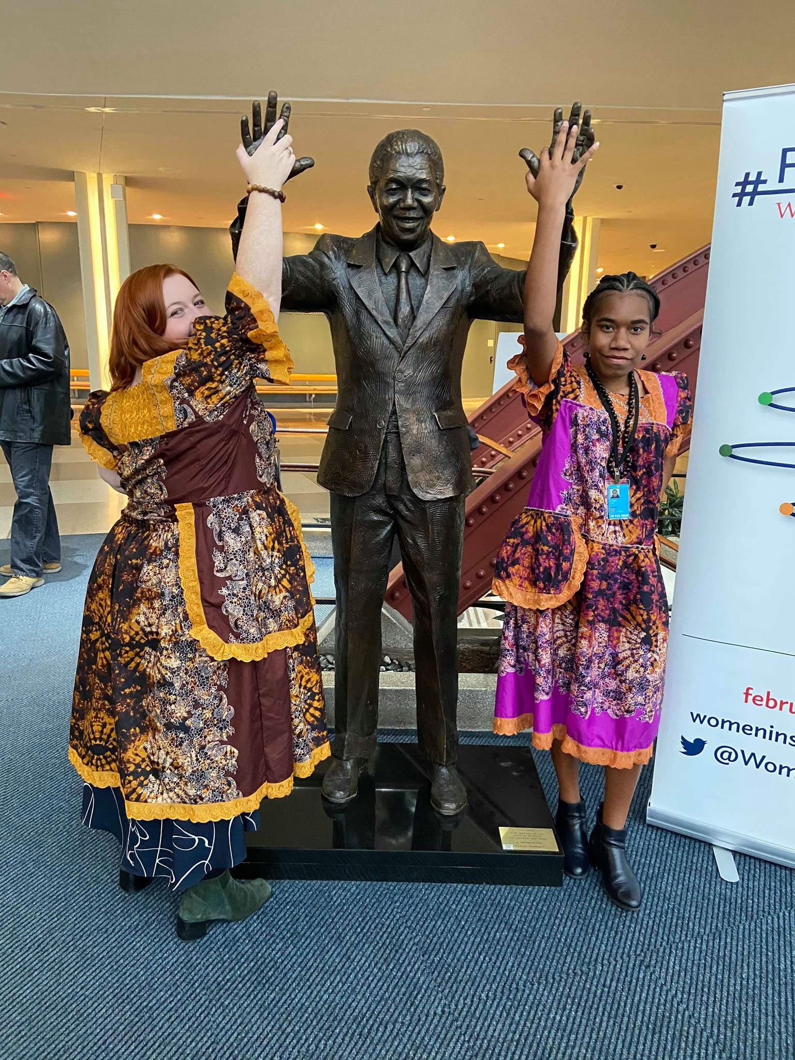
Notes:
In preparation for the commission UNANIMA International had notable input to the joint preparation efforts of the Working Group to End Homelessness and the NGO Committee for Social Development. These groups put significant time into pre-commission advocacy, draft resolution writing and civil society organizing.

Slide 74
UNANIMA INTERNATIONAL’S SIDE EVENT – HIDDEN FACES OF HOMELESSNESS
Former President of Ireland
Lived Experience
Service Provider
Special Rapporteur
Member State Representative
UNANIMA International Representative
You can watch the full event on our Facebook page at: https://www.facebook.com/unanimaintl/videos/1023186921388896/
Notes:
UNANIMA International held a very successful side event at the United Nations on Tuesday, February 11th 2020. Titled: “The Hidden Faces of Family Homelessness from the Perspective of Women and Children/Girls,” the event comprised a panel of speakers who presented from a variety of perspectives and areas of expertise. This enabled an open dialogue to discuss the drivers of family homelessness, good practices from various state and non-state stakeholders, policy recommendations, and to give a voice to women and children/ girls who have experienced Homelessness/ Displacement.
The event was moderated by Sister Winifred Doherty, Main NGO Representative to the United Nations from The Congregation of Our Lady of Charity of the Good Shepherd.
Micheal Tierney from the Irish Mission to the United Nations- made opening remarks and welcomed Former President of Ireland.
Mary McAleese- Followed on from her Keynote Address at the Commission for Social Development’s High Level Panel Discussion the day before, continuing to express her stance on homelessness, which is that “a safe, affordable home should be a right for everyone.” She spoke of her experience being displaced during “The Troubles” in Northern Ireland, and urged governments to take action on homelessness, advising: "A person has no home? Give them a home. That should be our response to all housing crises."
Philip Alston, the Special Rapporteur on Extreme Poverty and Human Rights- addressed the audience via video message from Spain and spoke about Family Homelessness and its intersections with poverty, specifically in regards to women and children.
Keisy Ureleo from Vanuatu- spoke of her personal experience of homelessness and displacement following a volcanic eruption on her island, that made her home uninhabitable, and the way in which it affected her community, specifically her and her peers still in school.
Tony O’Riordan, the CEO of Sophia Housing, Ireland (which was originally founded by Jean Quinn, DW) spoke from the perspective of a national non-profit provider of housing and support services, highlighting “Housing First,” as a good practice. Kirin Taylor, UI’s research fellow- Spoke of her recent trip to the slums of Kenya, and detailed the research into family homelessness thus far. She also spoke about UNANIMA International’s publications: You can watch the full event on our FaceBook page at: https://www.facebook.com/unanimaintl/videos/1023186921388896/

Slide 75
UNANIMA INTERNATIONAL CSOCD58 HIGHLIGHTS
Former President of Ireland Mary McAleese as the Keynote Speaker and Jean Quinn, DW as the civil society representative on the High-level panel on the priority theme.
You can watch a number of our presentations and events on UN TV via this link: http://webtv.un.org/search?term=CSocD58&sort=date
Notes:
Throughout the commission UNANIMA International worked with our attending delegates and colleagues at the UN to ensure the voices of Civil Society and individuals and families with a lived experience were heard, our major points of advocacy were centered around ensuring the issue of family homelessness was discussed in the context of the theme. Among the many highlights of the Commission was having Former President of Ireland Mary McAleese as the Keynote Speaker and Jean Quinn, DW as the civil society representative on the High-level panel on the priority theme. Each of the women spoke eloquently advocating for the voices of people experiencing homelessness (especially women and children) to be heard and included in the conversation, the adoption of a global definition, housing with supports as a solution to homelessness and most importantly that Homelessness be addressed as what is it a civil and human rights failure born from structural failure of the state not people experiencing it.

Slide 76
OUTCOMES OF CSOCD58
Historic resolution on the priority theme “Affordable housing and social protection systems for all to address homelessness.” The first on the topic of homelessness in the history of the UN
There definition was not noted in its original form, rather affirmation of the definition put forward by the Expert Group in Nairobi was made throughout the document
The resolution addressed homelessness in the context of vulnerable groups and different demographics including women and children
Families were mentioned several times throughout the document
Whats next?
The resolution will now be submitted to the United Nations' Economic and Social Council for approval.
Advocacy does not stop here!!
Notes:
At the close of the commission the historic resolution on the priority theme (Homelessness) was presented and passed by the commissions members. Supporting several of the points UNANIMA International and our colleagues had advocated for before and during the commission meetings was a great display of collaboration and willingness to address the issue. While the definition put forward in Nairobi at the Expert Group Meeting was not adopted in its original form the outcome document's description of homelessness affirmed a working definition and paves way for a potential definition into the future. The resolution also also addressed homelessness in the context of vunerable groups and different demographics including women and children which was a key concern and point of advocacy for UNANIMA International. The resolution will now be submitted to the United Nations' Economic and Social Council for approval. Some of the text may then go to the U.N.'s General Assembly. Going forward it is hoped member states will respond to these outcomes taking greater action on the issue of homelessness. From a civil society point of view we must now explore how various countries might implement the resolution and how to advocate for this to happen in a successful manner.

Slide 77
UNANIMA INTERNATIONAL & YOU

Slide 78
UNANIMA AND YOU
Wherever you are...
Contribute to UI’s mission locally
Tell us what you’re doing
Respond to requests and surveys
Work together with your congregation and fellow UI members in your area
Contribute the VNRs
Attend regional conferences and commissions
Keep up to date with your countries policies, priorities and UN activity
In NYC
Attend other Commissions or Forums
Attend CSW, CSocD, HLPF, ECOSOC Youth Forum + more
Apply for the Catherine Ferguson Scholarship
Notes:
Refer to what is on slide name and email in chat box we will connect you stories with you director ccd

Slide 79
HOW DO YOU GET INVOLVED WITH OUR RESEARCH?
Contribute to our Research – Send us your stories through our website
Tell us what you are doing in your communities in response to homelessness and displacement – Send us your stories through our website
Volunteer – Check out the different ways you can volunteer with us on our website
Keep up to date with our Social Media – Like, comment and share our post across Facebook, Twitter and Instagram
Share your Expertise– Contact our office to share your expertise

Slide 80
WOMAN OF COURAGE - Jean
Awarded annually since 2008
Awarded to a Woman that has demonstrated courage in the face of adversity
Reflects and supports the values and principles of the UN
Nominated by one or more UI Congregations
Displays courage that related to UI’s major areas of concern
Notes:
The Woman of Courage Award is presented annually at a special ceremony, which takes place in New York or in the awardee’s home community. Each year women (Non- UI members) are nominated by Members of UNANIMA International. It is awarded to a woman who has demonstrated courage in the face of adversity (e.g. from government, popular opinion, leaders), whose actions reflect and support the values and principles promoted by the UN and display of courage relates to one of the major areas of concern for UNANIMA International. In 2018 the Woman of Courage award celebrated its 10th year, the past awardees collectively represent diverse geographical regions, missions and ages.

Slide 81
WOMEN OF COURAGE
Water Activist
2008
2009
Migrant workers
2016
Peace Activist
2014
Women’s Rights & Trafficking
Poverty, HIV & Trafficking
2009
2012
Integrated Sustainable Empowerment
2013
2018
Education & Trafficking
2010
2015
2011
Water Activist
Education & Health
Environmental Activist
The Disappeared Advocate & Trafficking
2017
Education

Slide 82
WOMAN OF COURAGE 2019
Unanima International are delighted to announce that the recipient of the Woman of Courage Award 2019 is the former President of Ireland, Mary McAleese.
The Award was be presented to Mary at an event in New York in February 2020 during the 58th Commission for Social Development.
Notes:
In 2019 UI is delighted to present the Woman of Courage award to former President of Ireland Mary McAleese.
Mary McAleese served as the eighth President of Ireland, 1997 – 2011, and was the first Irish President born in Northern Ireland. The eldest of nine children, she grew up in Northern Ireland through the violent times that have come to be known as ‘The Troubles’. Her family was one of many adversely affected by the conflict.A graduate of Trinity College Dublin, she received her law degree from Queen’s University of Belfast. Prior to her distinguished term as President, she held several positions in higher education, including Reid Professor of Criminal Law, Criminology and Penology at Trinity College Dublin and Director of the Institute of Professional Legal Studies and Pro-Vice Chancellor at Queen’s University of Belfast. McAleese described the theme of her Presidency as "Building Bridges”, which was reflected in her efforts towards reconciliation and peace building within Northern Ireland and between the North and the South. Improving the living standards for those living in poverty, of promotinga dialogue and consensus internationally to resolveconflicts and disputes instead of violence were among the many strategies she implemented to achieve this. She made social inclusion, equality, and reconciliation, sharing and caring the themes of her incumbency. As President of an increasingly prosperous and harmonious Ireland, she worked to extend the experience of transformation beyond Ireland's island shores as a story of hope for all people. By succeeding a popular President who was also a woman, McAleese is also a prominent role model and advocate for gender equality.

Slide 83
WOMAN OF COURAGE 2019 CEREMONY
Presented to Former McAleese for her , for her numerous and rich contributions to both civil and church society. This award celebrates her ongoing commitment to the struggle for peace, justice, equality, human dignity and respect for all, especially individuals and families left furthest behind.
Held at the United Nations
Guests included: UN Officials, NGO community, UNANIMA International Directors and Mary’s Guests.
Notes:
UNANIMA International’s annual Woman of Courage Award Ceremony was held in the Delegates Dining Room at the United Nations on the evening of Tuesday February 11th— another significant event to take place during the exciting two weeks of the 58th Commission for Social Development. The ceremony was held to award and honor the 2019 winner, Former President of Ireland, Mary McAleese, for her numerous and rich contributions to both civil and church society. This award celebrates her ongoing commitment to the struggle for peace, justice, equality, human dignity and respect for all, especially individuals and families left furthest behind.
Mary McAleese, who was President of Ireland from 1997 to 2011, had “Building Bridges” as the theme of her presidency, which was reflected in her efforts towards reconciliation and peace building within Northern Ireland. She worked towards justice, social equality, social inclusion, anti-sectarianism and reconciliation, and she was a voice against the forces of oppression, discrimination, and poverty. Both courageous and deeply appreciated by many, including the women at UNANIMA International, Mary displays and gives action and a voice to the values of UNANIMA International and the United Nations.
The evening was very special, with opening remarks given by Molly Gerke, UNANIMA International’s Executive Assistant, the presentation of the award conferred by UNANIMA International’s Director, Jean Quinn, and an acceptance speech by Mary McAleese. Several UNANIMA International’s Board Members, supporters from other NGOs, UN delegates, and Mary’s personal guests were in. During her address she gave encouragement that UNANIMA International must continue its important work, and her thanks that she was able to be a part of it.

Slide 84
WOMAN OF COURAGE 2020
Unanima International are delighted to announce that the recipient of the Woman of Courage Award 2020 is the Sr. Séraphine Ratavy!
The Award Will be presented to Mary at an event here in Madagascar!
Notes:
In 2020 UI is delighted to present the Woman of Courage award to Sr. Séraphine Ratavy, a Daughter of Wisdom!
The Daughters of Wisdom opened a new mission in Nomad, Papua New Guinea. It is in the remotest part of the Daru-Kiunga Diocese, only accessible by small plane. It is a 30 minute flight to the nearest shops. Sr. Séraphine Ratavy, from Madagascar, arrived in PNG in 2013 and was directly assigned to Nomad to work with the village people.
In the beginning, she used her agriculture skills to work with the women who lived close to the main station, whilst at the same time testing the soil and rainfall. She set up a women’s club and taught sewing, and trained some young women to help her. As she became established there her wish was to reach the surrounding villages, which were very isolated. Eventually she found the small Gebusi Tribe, living a few hour’s walk and a canoe ride from Nomad. These people became the focus for Sr. Seraphine in this area, and she worked with the men and women in all fields of learning.
When she first arrived in the village, the people danced, sang and welcomed Sister Seraphine who had travelled thousands of miles to come to them. As a talented and practical woman with competence in agriculture, she risked stepping out of her comfort zone by learning English as well as the language of the people. Sr Séraphine taught women and men sewing, agriculture, nutritious cooking, health and hygiene, knitting, and farming.
After some time, due to difficulties of communication, travel between Kiunga to Nomad, and in getting work for the nurses in the health centre, the decision was made to close the community at Nomad. For two years, up until 2018, Sr Seraphine visited the place 4 or 5 times a year: as much as it was necessary to continue empowering the women and men of the place.
Sr. Seraphine continued to assure the mission here?. Later, when there was no direct possibilities to arrive in Nomad, the Yulabi people built her a nice little house on stilts where she could sleep when visiting them, and assured security for her by walking with her to Nomad for 2 to 3 hours.
She lived in the bush hamlets of about ten small family houses and ate their food—mainly kokoro banana. She listened to their joyful and sorrowful stories. The people honored her as their Saviour by providing security, native food, and water when she was out on patrol. Surely to walk in such a mission was difficult yet enriching!
These neglected tribes in the forest were curious to learn new things. They had taken a huge step in learning. Soon they learned to cultivate rice and groundnuts, as well as many kinds of new fruits and vegetables. They also learned to take care of their health and hygiene. What a privilege to empower these people in their great poverty.

Slide 85
GET CONNECTED
Our Brand New Website Is Up and Running!! Check it out here!!
https://unanima-international.org/
@UNANIMAIntl
Or go to: https://twitter.com/UNANIMAIntl
Where to Find Us…
UNANIMA International Office 757 Third Avenue, Suite 2014 New York, NY, USA 10022
+1 929 259 2105
Search: UNANIMA International
Or go to: https://www.facebook.com/pg/unanimaintl/posts/
@UNANIMAInternational
Email us @ info@unanima-international.org
Notes:
Push the social medias!! Encourage people to get their phones out and follow us on them if you can. Mention they can sign up to receive the Newsletter directly by emailing the address here with their name, email address and language in which they would like to recieve it. Mention Family Homelessness Thursdays.

