Slide 1
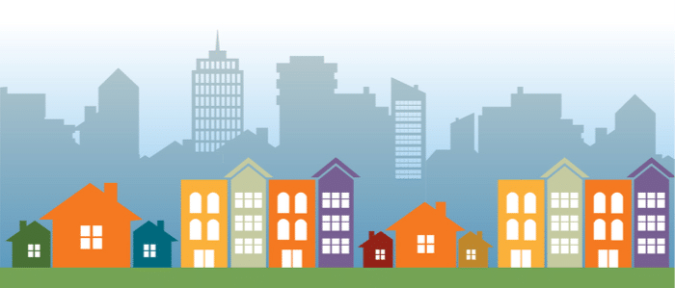
The State of Homelessness in India:
families, women and children
Marianna Kozak and Isabelle Nicolay
September 2019

Slide 2
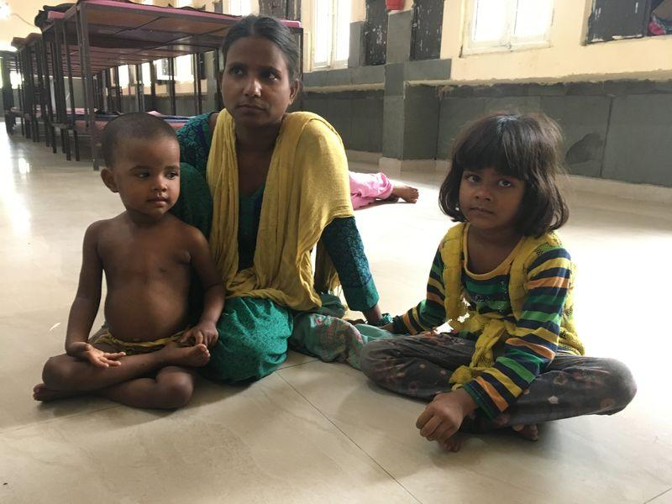
Table of Contents
Defining and Measuring Homelessness
Statistics: Homelessness
Testimonials
Root & Structural Causes of Homelessness
Trauma
Sustainable Development Goals
Programs & Policies: Governmental & Other
Potential Partnerships
Recommendations
Research Shortfalls & Future Research

Slide 3
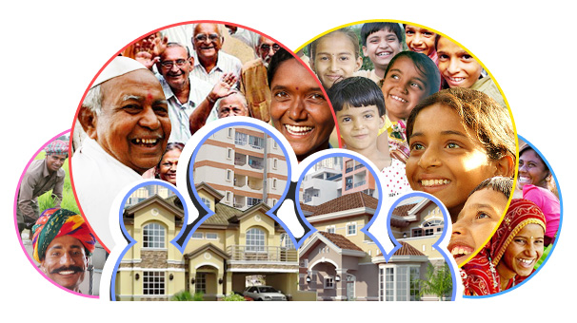
India: Defining and Measuring Homelessness
Indian Census Definitions:
Houseless Persons: persons who are not living in buildings or ‘census houses’
Includes those living ‘in the open’, noting roadsides, pavements, hume pipes, under flyovers and staircases, railway platforms, porches and open in places of worships
Household: ‘A group of persons who commonly live together and would take their meals from a common kitchen unless the exigencies of work prevented any of them from doing so.' ​
Family homelessness is not a term that appears in Indian Census data
Notes:
Isabelle

Slide 4
Other Definitions of Homelessness
Universal Declaration of Human Rights (UDHR)​: Article 25.1: “Everyone has the right to a standard of living
adequate for the health and well being of himself and his family... and the right to security”
UN Human Settlements Programme (UN-Habitat): “Households without a shelter that would fall within the scope of living quarters.”
United Nations Development Program ​conducted a homelessness survey in Delhi in 2010, broadening the Census definition to include men, women, eunuchs, and children ​who do not have a home or settled place.
UNANIMA International: “Families who do not have consistent residency or the support needed to maintain a residency of their own who live episodically, temporarily or chronically in temporary housing, including shelters and locations not intended for human habitat or settlement.”
Notes:
Marianna

Slide 5
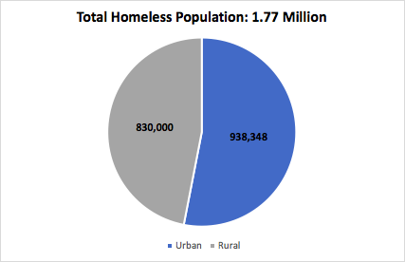
Statistics: Homelessness
Population of India: 1.2 billion people
Population living in multidimensional poverty: 632 million people
Homeless Population (2011 Indian Census): 1.77 million people
Homeless Population (Other Estimates): 2.3 - 3 million people

Slide 6
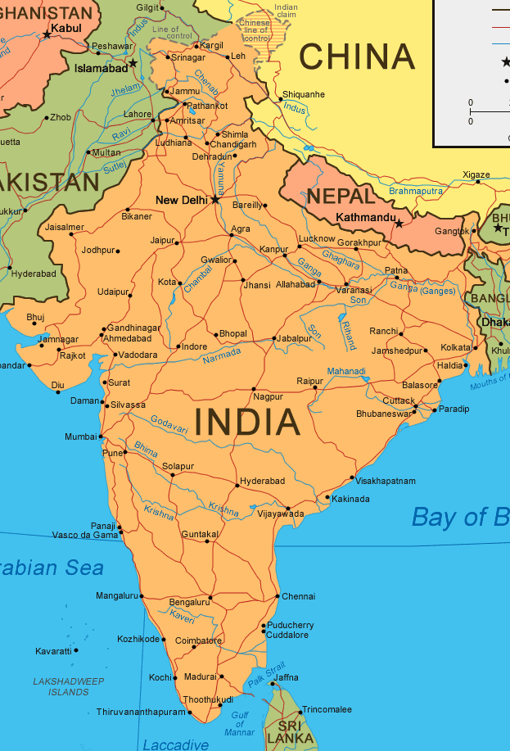
Statistics: Homelessness - Urban Populations
New Delhi:
150 -200,000
Kolkata: 150,000
Mumbai:
200,000
Bengaluru:
40 -50,000
Chennai:
40 - 50,000
Notes:
Isabelle

Slide 7
Statistics: Homelessness - Women
Women comprise 10% of India’s homeless population
Increased Vulnerability:
Homeless single mothers, women affected by substance abuse, pregnant women, and women living with HIV/AIDS.
Two categories of homeless women:
Women who stay with their families
Women without any family
Livelihood:
Roadside vending or other activities
Many resort to begging
Notes:
Marianna

Slide 8
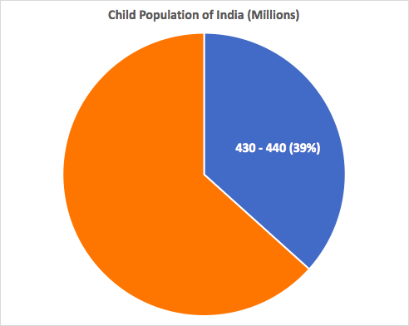
Statistics: Homelessness - Children
170 million (40%) of children are destitute
12% of children are orphans
100,000 homeless children in New Delhi
314,000 homeless children in Mumbai, Kolkata, Chennai, Bengaluru, Kanpur and Hyderbabad
Key Facts & Terms:
Street Children comprise 50% of the homeless population
Vulnerable Children
Children “Of The Street” vs Children “On the Street”
Notes:
Marianna

Slide 9
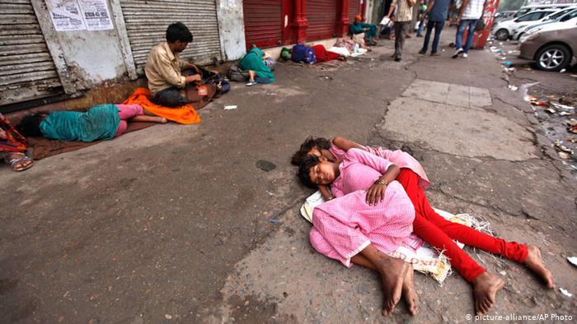
Testimonials
Kaur
“Here, the police harass us, and the locals curse us, and I’m sometimes too afraid to sleep. But we cannot afford to pay rent and the shelters are not good, so what option do we have?”
Poonam Das
“Poonam finally had a thorough medical examination, and was admitted at 11:20pm, almost 24 hours after she was first taken to the hospital.”
Laxmi
“After laying with her new baby on a footpath with no food or medical assistance, Laxmi died of septicemia on the street four days after giving birth.”
Notes:
Marianna

Slide 10
Root Causes of Homelessness
Inequality in Adequate, Affordable Urban Housing:
27% in informal rental accommodations
Urban Housing Shortage (2012): 18.78 million
95% of urban housing shortages among lower socioeconomic groups
Inequality in Tenure Rights:
10% of the population controls 55% of lands
60% percent of the population controls near 5%
Inequality in Rural Housing:
2011 Census: 69% of India’s population is rural
Rural Housing Shortage: 40 million
Population in Slums: 13.75 million households
Lack of Enfranchisement:
Denial of voter identification cards
2010 UNDP: 3% of homeless in possession of a voter ID
Notes:
Isabelle

Slide 11
Root Causes of Homelessness: Women
Domestic Violence:
Breakdown of Family Units: Women may be cast out due to illness, may be abandoned by their husbands, may be evicted from their homes after the death of their husbands, or be abandoned after their husbands/fathers remarry.
Housing Discrimination: Single women, constituting 8.6% of the country, face obstacles in accessing land and housing, often needing third party assistance.
Other Factors: Lack of information regarding women’s rights, lack of access to social services, inadequacy of the law protecting homeless women.
2016: 29% of women between 15-49 have experienced lifetime physical or sexual partner violence.
Notes:
Marianna

Slide 12
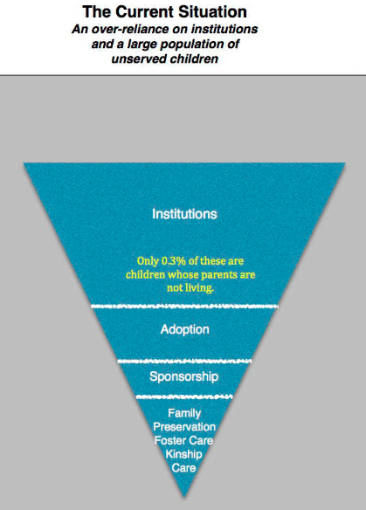
Root Causes of Homelessness: Children
Resistance to Alternative Care Solutions
Many families question why intervention is now necessary for what was previously considered a family matter.
Under Hindu law, the dominant religion in India, fostering holds no rights or obligations for children, and therefore holds no religious significance, whereas adoption does.
Notes:
Marianna

Slide 13
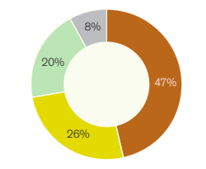
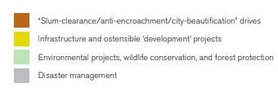
Structural Causes of Homelessness
Criminalization of Homeless:
Criminal Procedure Code (1973)
Bombay Prevention of Begging Act (1959)
Slum Areas [Improvement and Clearance] Act (1956) ​
Forced Eviction ​& Displacement:
41,700 homes demolished by government in 2018
202,000 people forcibly evicted
Disaster & Conflict Displacement:
Between 2008 and 2014: 30 million people displaced due to natural disasters
2015: 600,000 people displaced due to armed conflict and religious violence
Temporary Relief Camps: Lack of adequate alternative housing
Notes:
Isabelle

Slide 14
Structural Causes: Lack of Shelters for Women & Children
Legislation:
PUCL v. Union of India and Others
One homeless shelter for every 100,000 people in the area
Shelters must function for 24 hours a day, year-round
Shelters to provide 50 square feet/person
October 2010, Delhi to “demarcate five secured shelter homes exclusively meant for destitute women, pregnant and lactating women,”
Current Situation in Shelters:
Most shelters provide 15 square feet of space
Unsanitary and largely uninhabitable space.
Located in inconvenient or inaccessible locations
Inadequate protection against violence
No healthcare for residents
Delhi: 201 shelters in 2014, 20 of which were exclusively for women and their children
232,936 children are sheltered in 7,189 child care institutions across India
5850 of those institutions are registered with the government 1339 are unregistered
Notes:
Marianna

Slide 15
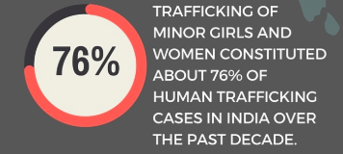
Trauma
Violence:
Homeless women are 10 times more vulnerable to verbal and physical abuse than homeless men, and at greater risk for sexual exploitation.
Women face abuse from police, passersby and other homeless men.
Women face the threat of possessions being destroyed, especially with police confiscating wares for sale on the street by homeless women.
Trafficking:
Multiple Purposes: commercial sexual exploitation, exploitative labour, organ sale, begging, camel jockeying.
Traffickers lure victims with the prospect of jobs, marriage, adoption and money, and also use force
Young girls are most susceptible to trafficking: 53% increase in​ the trafficking of minor girls in​ 2015 as compared to 2014
Notes:
Marianna

Slide 16
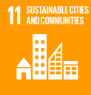
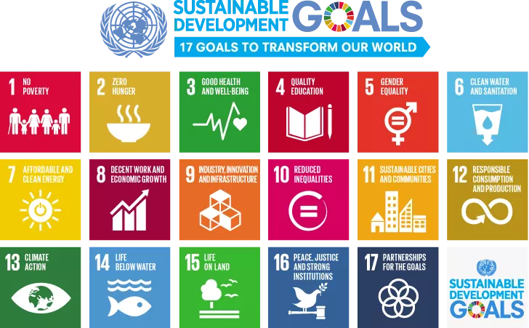
Sustainable Development Goals
Make cities and human settlements inclusive, safe, resilient and sustainable
Promote peaceful and inclusive societies for sustainable development, provide access to justice for all and build effective, accountable and inclusive institutions at all levels
Notes:
Isabelle

Slide 17
Obligations of States
The International Covenant on Economic, Social and Cultural Rights​ (ICESCR): “the right of everyone to an adequate standard of living for himself and his family, including adequate food, clothing and housing and to the continuous improvement of living conditions.”
The UN Convention on the Rights of the Child (UNCRC)​,​ “provides an inclusive structure for policy and programme development to promote and protect the rights of children.”
The Istanbul Declaration and the Habitat Agenda,​ ​ “legal security of tenure and equal access to land to all people, including women and those living in poverty; and undertaking legislative and administrative reforms to give women full and equal access to economic resources, including the right to inheritance and to ownership of land and other property”
Notes:
Marianna

Slide 18
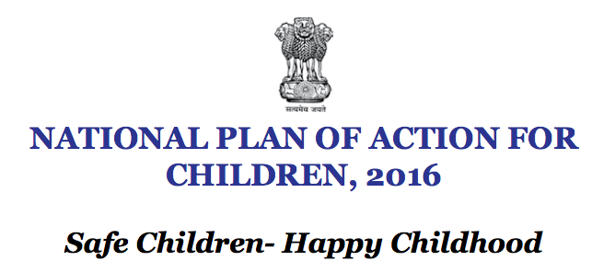
Government Programs & Policies
The Constitution of India:
Article 21: “No person shall be deprived of his life or personal liberty except according to procedure established by law.”
Article 15: “​nothing in this Article shall prevent the State from making any special provisions for women and children.”
Article 39(f): “​children are given opportunities and facilities to develop in a healthy manner and in conditions of freedom & dignity”​
Creates a distinction between Juveniles in Conflict with the Law and Children in need of Care and Protection
Identifies Four Key Priority Areas, which include: survival health and nutrition, education and development, protection and participation.
Notes:
Marianna

Slide 19
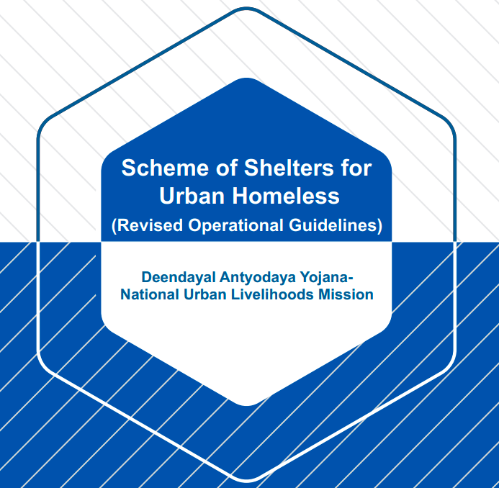
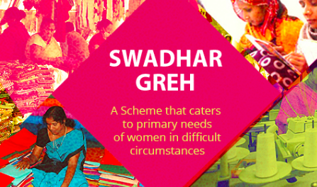
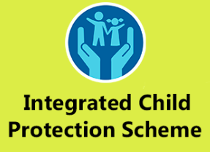
Programs Addressing Homelessness
Integrated Child Protection Scheme
National Livelihoods Mission—Scheme of Shelters for Urban Homeless
Swadhar Greh
UJJAWALLA Scheme for Prevention of Trafficking and Rescue, Rehabilitation and Reintegration of Victims of Trafficking
Housing For All (Pradhan Mantri Awas Yojana, PMAY)
Smart Cities Mission (SCM)
Notes:
Isabelle

Slide 20
Potential Partnerships
Notes:
Marianna

Slide 21
Recommendations
Demand the government re-define ‘Homelessness’ and define ‘Affordable Housing’.
Ensure the 2021 Census questionnaire provides improved and reliable disaggregated data on homeless women, children and families. ​
Demand greater attention to development in rural areas, particularly with regard to adequate housing.
Address inadequacy and inconsistency of government programs, missions and schemes by developing nations laws that address adequate housing and homelessness in urban and rural centers.
The Indian Government must oversee the creation of homeless shelters specifically targeted towards homeless women and children.
Notes:
Isabelle

Slide 22
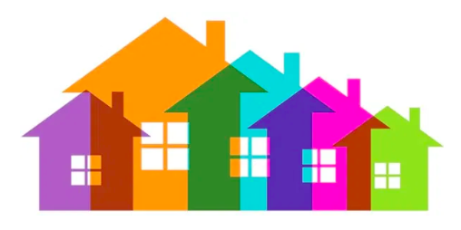
Research Shortfalls & Future Research
Research Shortfalls:
Lack of available data
Inability to conduct interviews
Future Research:
Begin research on the topic of homelessness at the media level.
Delve early on into available research by different divisions of the United Nations​. UN Women, UN Development Program UNICEF and UN Habitat have been key to finding credible quantitative data on the subject.
Realize ‘homelessness’ will not always be the key word in the investigation​.
Notes:
Isabelle

